Slide 1
MARKETING TOOLS, TIPS & TAKEAWAYS
Clever Tools for Clever Marketing

Slide 2
Arianna Howe
Vice President, Client Services
We weren’t ready for award season to be over just yet.
Dustin Hawes
Sr. Social Media Strategist
Notes:
Notes: Do you find yourself spinning your wheels at work? Wishing you had more time, or your project was more organized?
Arianna + Dustin

Slide 3
Do you find yourself spinning your wheels at work?
We weren’t ready for award season to be over just yet.
Notes:
Notes: Do you find yourself spinning your wheels at work? Wishing you had more time, or your project was more organized?
Arianna

Slide 4
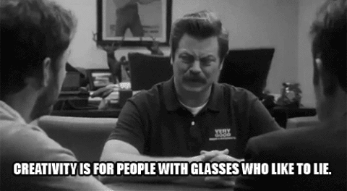
Wishing you were born with an ounce of creativity?
We weren’t ready for award season to be over just yet.
Notes:
Maybe there are times you wish you were born a designer, or a photographer, or just with an ounce of creativity?
Dustin

Slide 5
Do you find yourself lost in a sea of data?
We weren’t ready for award season to be over just yet.
Notes:
Do you find yourself lost in a sea of data you don’t know how to make sense of?
Arianna

Slide 6
Are there times when you have no idea where to start?
We weren’t ready for award season to be over just yet.
Notes:
Are there times when you have no idea what the status of your project is? Or that that one thing you were suppose to make happen, was suppose to happen a week ago?
Dustin

Slide 7
Maybe sometimes you just feel overwhelmed…
We weren’t ready for award season to be over just yet.
Notes:
Arianna

Slide 8
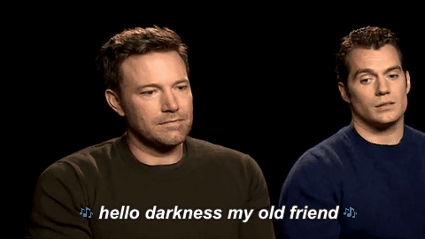
Defeated…
We weren’t ready for award season to be over just yet.
Notes:
(let this one run for a second cause the GIF is fire!)
Dustin

Slide 9
Like you're being pulled in a million directions…
We weren’t ready for award season to be over just yet.
Notes:
Arianna

Slide 10
Or like, you just can’t even…
We weren’t ready for award season to be over just yet.
Notes:
Dustin

Slide 11
We’re here to help.
We weren’t ready for award season to be over just yet.
Notes:
Arianna

Slide 12
We weren’t ready for award season to be over just yet.
Take back the rest of your day with all the time you’ll save with these clever tools.
Notes:
And because we aren’t ready for award season to be over just yet, our aid is coming in the form of the Oscars—the Clever Tools Oscars.
These tools will shave off minutes from your day, save you from face-to-face interaction with humans, and keep you so organized, you may think you've come down with Type-A personality syndrome.
Dustin

Slide 13
We weren’t ready for award season to be over just yet.
Without further ado, let the show begin.
Notes:
Dustin

Slide 14
The Oscar’s of
CLEVER TOOLS
Notes:
Dustin

Slide 15
A
PRODUCTION
Notes:
Dustin

Slide 16
In collaboration with
TRAVEL OREGON
OREGON RESTAURANT
& LODGING ASSOCIATION
Notes:
Dustin

Slide 17
Notes:
Dustin

Slide 18
The year has been filled with new and improved software tools, but few stand above as true winners. It's time to get going, so our first category of the night is…
Notes:
Arianna

Slide 19
The nominees for
PRODUCTIVITY &
EFFICENCY
are…
Notes:
Arianna

Slide 20
BASECAMP
DROPBOX
IFTTT
Notes:
Dustin

Slide 21
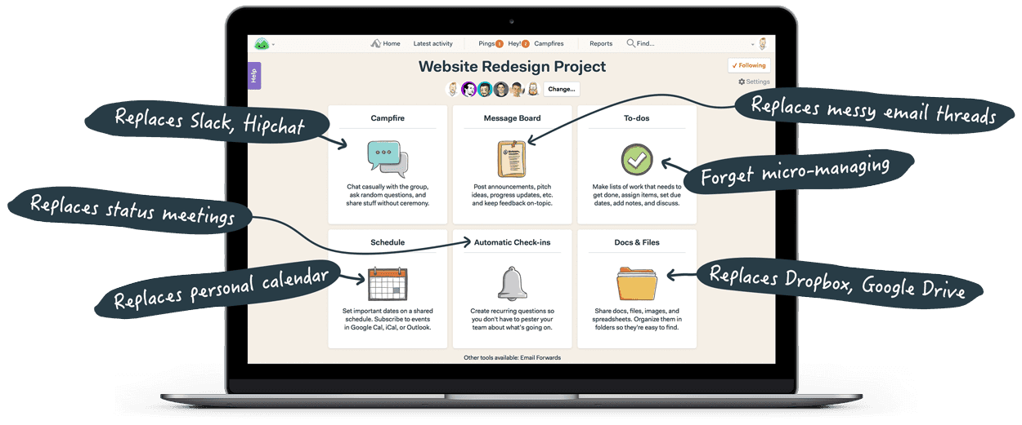
BASECAMP
Manages projects, internal communications, and client work in one place.
Organized, centralized, clear.
Notes:
Basecamp is a project management and collaboration tool. With this software, you can see the whole story of your project from top to bottom, assign work and see what’s done and not done so you don’t have to pester others, it has a simple chatroom feature
DUSTIN

Slide 22
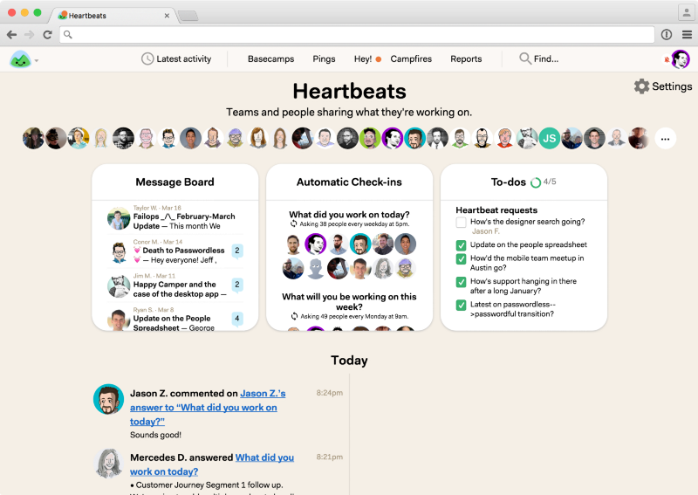
BASECAMP
Message Board
Automatic Check-ins
To-dos
Chatroom
Docs & Files
Notes:
It’s extremely easy to navigate. It keeps project management simple, but almost too simple—it’s not as robust as other online solutions.
DUSTIN

Slide 23
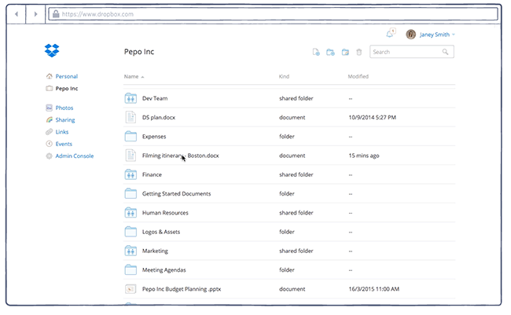
DROPBOX
File hosting service that simplifies the way you create, share and collaborate.
Notes:
Dropbox is a type of online cloud application that lets you store your files in the internet. You can share your files from computer to computer or to your phone as long as you have an internet connection. Often compared to a filing cabinet because you can upload documents from your computer and file them away in different folders.
Arianna

Slide 24
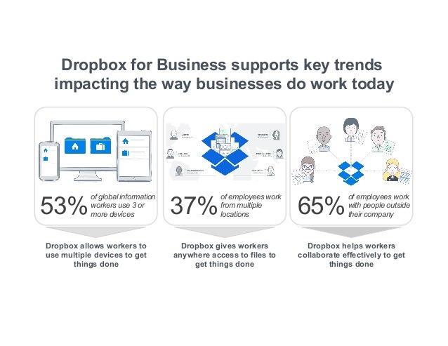
DROPBOX
Take your documents anywhere
Send videos quickly
Keep your photos safe
Work on slides together
Never lose a file again!
Notes:
Dropbox has a lot of awesome features, but it’s super beneficial to use instead of trying to shrink your email attachments exceeding 25MB! For business, you can also create a centralized database where all employees can access documents.
Arianna

Slide 25
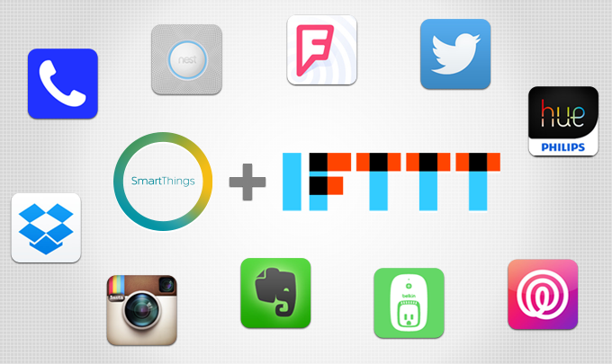
IFTTT
A free web-based (and mobile app!) service that allows you to connect your devices, platforms and services so they work together.
Easy way to automate tasks that might otherwise be repetitive or unable to talk to each other.
Notes:
IFTT (If This, Than That) has the slogan, "Put the Internet to work for you". The idea is that you use IFTTT to automate everything from your favorite apps and websites to app-enabled accessories and smart devices. Users are guided through a process to make simple scripts, or what they call “recipes,” where some type of event in one device or service automatically triggers in another.
Arianna

Slide 26
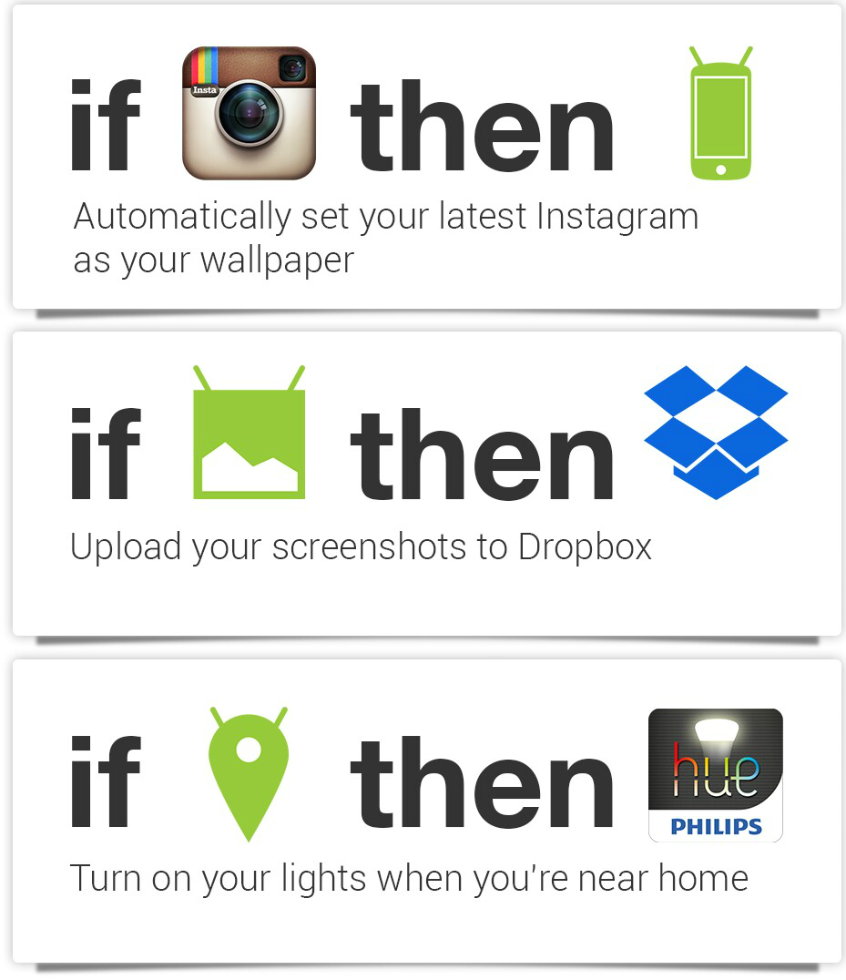
IFTTT
Currently supports more than 360 services/partners.
Notes:
A recipe that exists, for example, lets you keep your Twitter and Facebook profiles in sync, so when you change one, it’s triggered to change the other. You can also use IFTTT to automatically email readers when they comment on your WordPress blog.
Arianna

Slide 27
And the Oscar goes to…
BASECAMP!
Notes:
Why Basecamp should win:
It stays organized so you don't have too. It gets rid of messy email threads. Seamless. Sends you emails if you forget to check back. Great for group projects and having everything in one place.
Dustin

Slide 28
The nominees for
COLLABORATION
are…
Notes:
Dustin

Slide 29
BALSAMIQ
SLACK
EVERNOTE
Notes:
Arianna

Slide 30
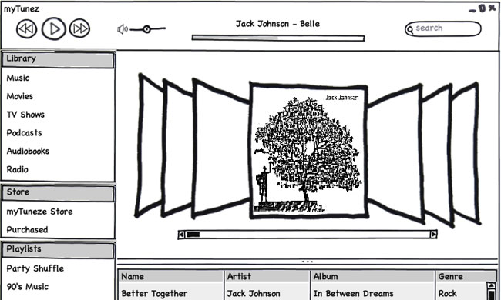
BALSAMIQ
A rapid wireframing tool.
Reproduces the experience of sketching on a whiteboard.
Notes:
Balsamiq is a “rapid, effective and fun wireframing software” that provides you with the ability to create wireframes using a really rough “sketch” style.
Arianna

Slide 31
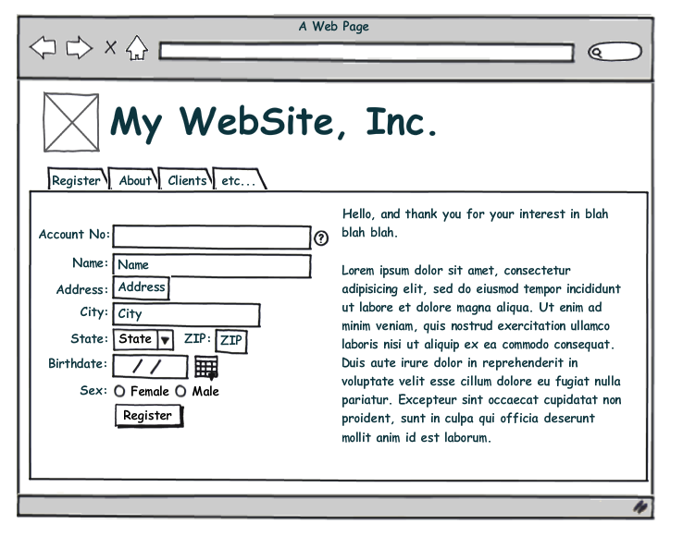
BALSAMIQ
Gets people on the same page before coding starts.
Has an easy UI.
Quickly export and send to clients or team members.
Notes:
Wireframing is a great tool to use to set the layout of your website before you go into the design itself. Let’s say you wanted to create a micro-site for a social campaign, any one, even nontechnical or those with a design background, can quickly and easily create a mock-up website. It’s affordable, but has limited sharing/collaborative options and you can’t make annotations on the interface.
Arianna

Slide 32
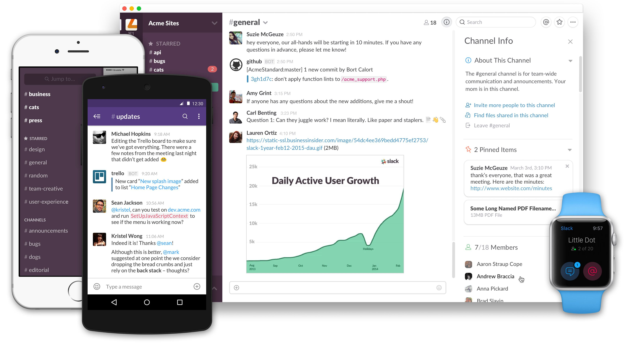
SLACK
Brings all your communication together in one place.
Works well as a collaboration tool too.
You can use across devices.
Notes:
Slack makes communication among team members not only easier, but better. The trick to loving this messaging platform is knowing when and how to use it, and what to expect from it. Does it replace email? No. Does it help cut back on needless internal email? Often, yes. In Slack, teams set up spaces, called channels, to have conversations. The big difference between it and email is that in Slack, most conversations are optional, whereas with email the assumption is that participation is required of all recipients.
Dustin

Slide 33
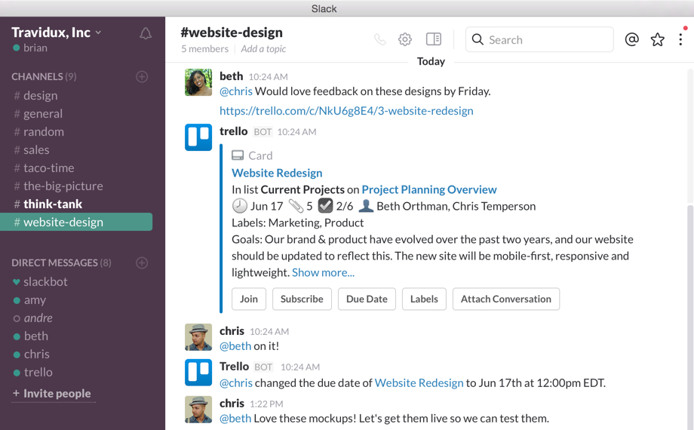
SLACK
Makes communication among team members easier and better.
Reduces email traffic.
Connects remote teams.
Can help personal productivity.
Notes:
Slack works very well as a collaboration tool in business because of its notifications, which are plentiful and customizable. It also supports audio and video calls. When people talk about Slack being a "pull" rather than "push" communication tool, they mean that information is freely available to you, but you have to go get it or pull it toward you. Contrast that to email, where information is pushed to you, and you are expected to consume it, even if it's not relevant. So the trick to using Slack effectively is figuring out how to make sure you're pulling the right information. Cons: can also be a total distraction and adds to the culture of people always expecting you to be accessible. Seems overwhelming to understand at first, but give it time.
Dustin

Slide 34
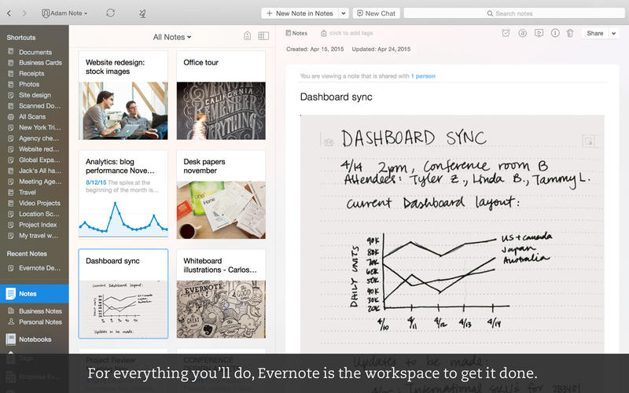
EVERNOTE
Cross-platform app designed for note taking, organizing, and archiving.
Syncs to the cloud so you can access your notes anywhere.
Notes:
Evernote is a place to record and save all your thoughts, notes, photos—whatever you upload—in the cloud so that you can get to all of it from your computer, smartphone, tablet, or anywhere you have an Internet connection and a browser
Arianna

Slide 35
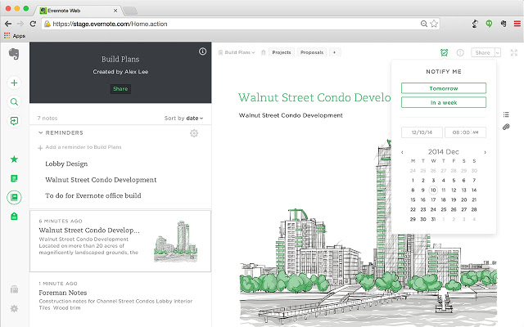
EVERNOTE
Capture brainstorming sessions.
Share notes with team.
Store documents.
Embed audio and images.
Web clipping features.
Notes:
This is useful to quickly capture business cards and organize contacts. It's also handy to keep notes from work meetings in one place and store travel information such as confirmation numbers, plane tickets, and hotel invoices for expense reports. Evernote can also keep maps, itineraries, To-Do Lists, and voice memos. Negative is that you can’t access stored notes if not on wifi
Arianna

Slide 36
And the Oscar goes to…
SLACK
Notes:
Why Slack wins:
Dustin

Slide 37
The nominees for
CREATION
are…
Notes:
Dustin

Slide 38
CANVA
UNSPLASH
SKITCH
Notes:
Arianna

Slide 39
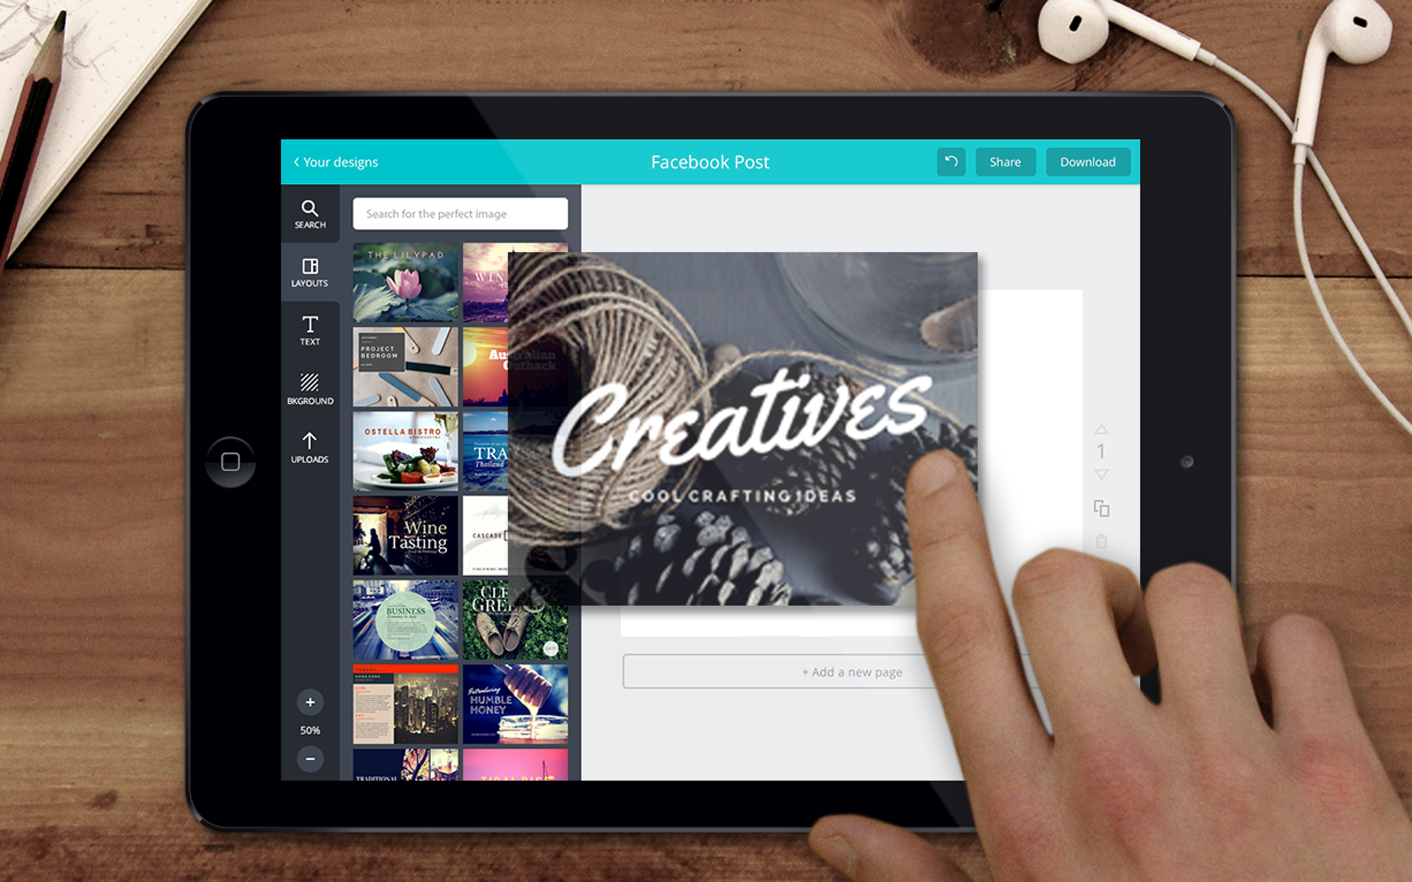
CANVA
Makes design simple for everyone.
Clean, intuitive layout with a library of over 1 millions images, fonts, icons, charts, graphs, and illustrations.
Notes:
Canva makes graphic design amazingly simple for everyone by bringing together a drag and drop design tool with a library of more than 1 million stock photographs, graphic elements and fonts.
Dustin

Slide 40
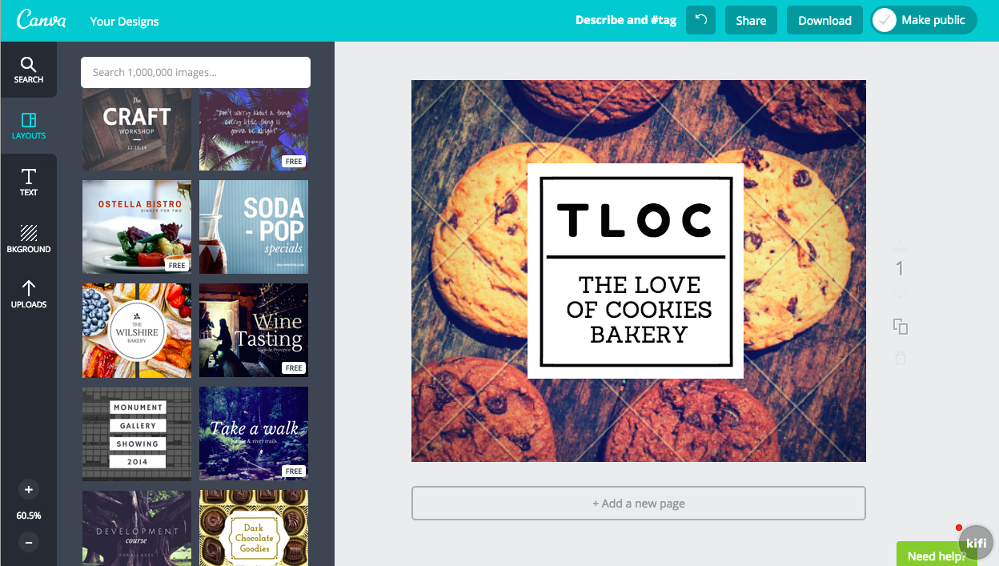
CANVA
Tons of preset templates and filters, also customizable.
Easily share via email or download it in a variety of file versions.
Share on social immediately.
Simple, great photo editing.
Notes:
If you need to make beautiful posters, invitations, cards, website graphics, or even multiple-page presentations, Canva is a design service you're going to want to use. Cons is that it can’t be interactive (no video embedding, animated features or live-data integration just yet!).
Dustin

Slide 41
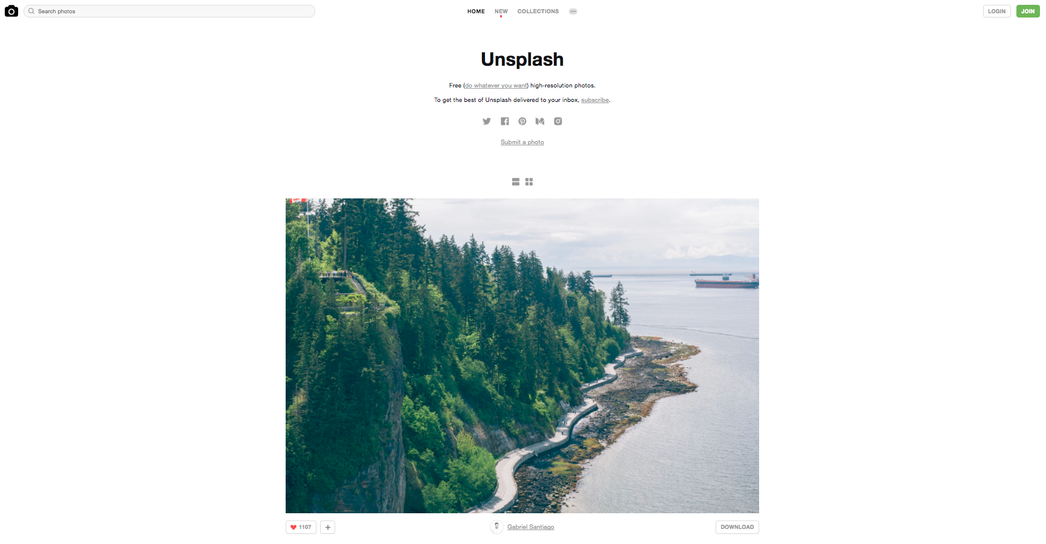
UNSPLASH
Free high-resolution stock photos.
All photos publish are CC0 licensed.
No permissions needed.
Notes:
Unsplash was originally a tumblr blog that, over the years, grew into a photography community. With Unsplash, you can download free, high resolution stock photos and use these images anywhere and in any way you want—even commercially!
CC0 (Creative Commons Zero) is a license allowing you to copy, modify, distribute and use the photos for free without asking permissions.
Arianna

Slide 42
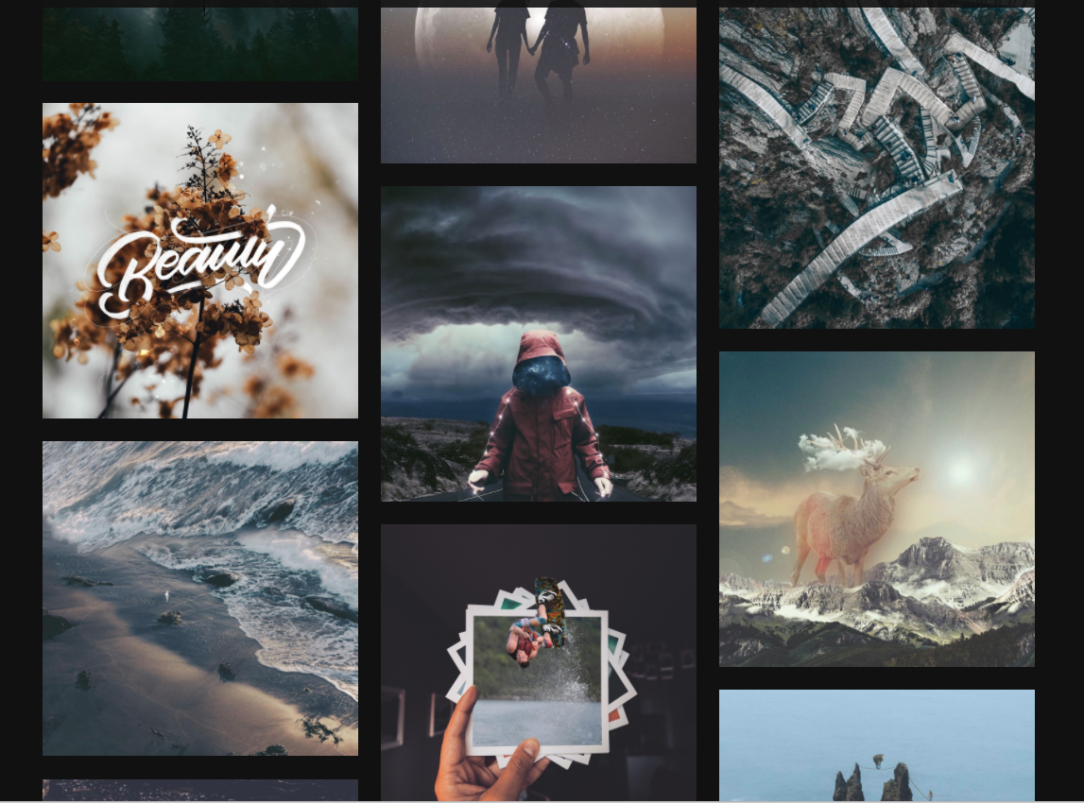
UNSPLASH
Additional images not posted to the main screen can be found within individual profiles.
High quality, unique images - like your dream Instagram account.
Instant downloads.
Notes:
Above image is samples of things made with images found on unsplash. Great to use for building presentations, stock imagery to make premium content like above, _____.
Arianna

Slide 43
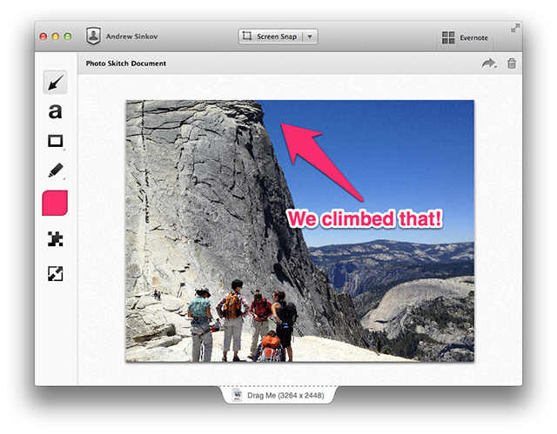
SKITCH
Snap. Mark up. Send
Screenshot from the web or upload from your computer.
Notes:
Part of the Evernote family, Skitch is an image editing tech resource. It’s designed to capture and mark up images on your computer or device with a variety of options.
Dustin

Slide 44
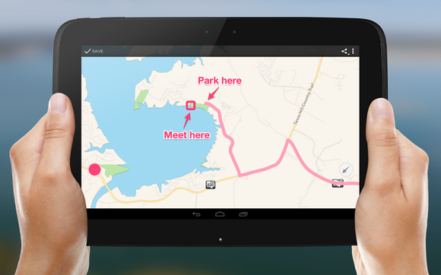
SKITCH
Doodle on or annotate images.
Erase parts of image.
Image resizing and rotation and cropping.
Edit PDFs, webpages, online maps
Much more!
Notes:
You can markup a photo, point things out on a map, markup a webpage, annotate a PDF, or use it as a fresh idea and draw something from scratch. Whether you need to share a quick screenshot with a client or coworker, crop a photo for a social post, or make a v unique meme, Skitch is a fast and frictionless way to capture, annotate, and share photos and screenshots.
Dustin

Slide 45
And the Oscar goes to…
CANVA
Notes:
Why Canva wins:
Dustin

Slide 46
The nominees for
ANALYTICS
are…
Notes:
Dustin

Slide 47
BIT.LY
FACEBOOK INSIGHTS
GOOGLE ANALYTICS
Notes:
Arianna

Slide 48
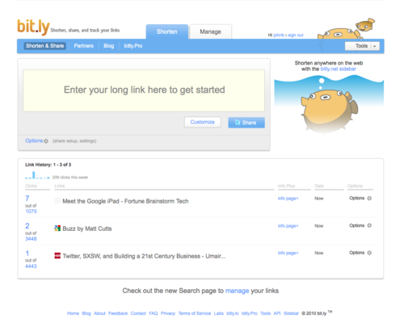
BIT.LY
URL shortener and link management service.
Customize links.
Analytics tools built in.
Notes:
bit.ly is a URL shorter and link management service that offers branded or customized links and analytics, allowing users to own their customer experience.
Arianna

Slide 49
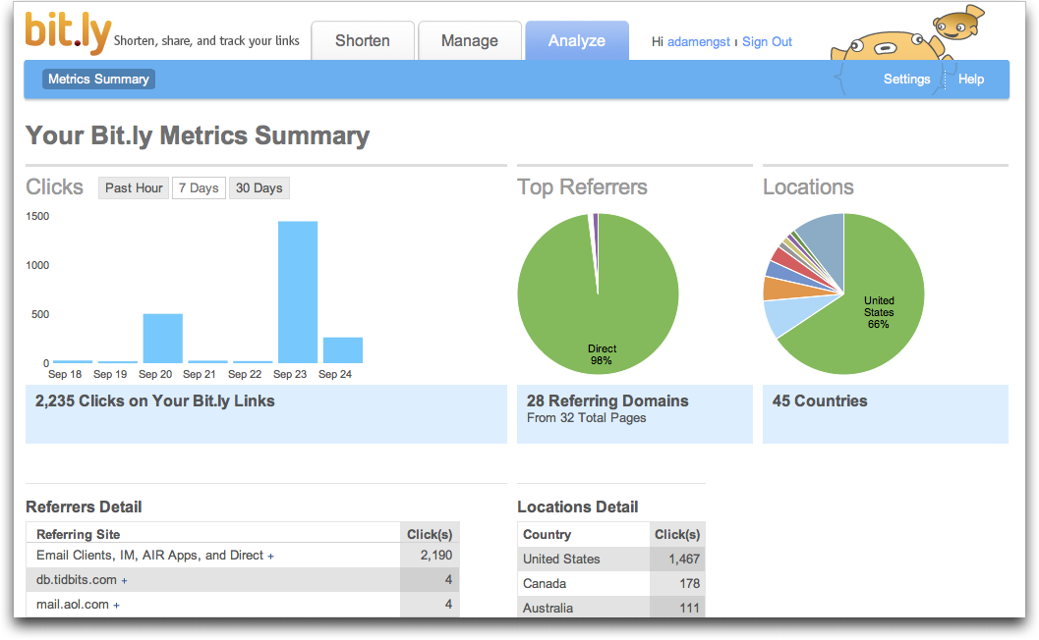
BIT.LY
Shorten, brand, and optimize your links.
Track individual links.
Collect insights
Chrome extension
Notes:
Once your links are shortened, you can track link analytics, gather audience intelligence, and measure campaign performance all in one location. With these insights, you can optimize your marketing efforts to better fit your audience or clients needs. This tool is great for any position that posts links whether that is on social media, your website, or via email.
Arianna

Slide 50
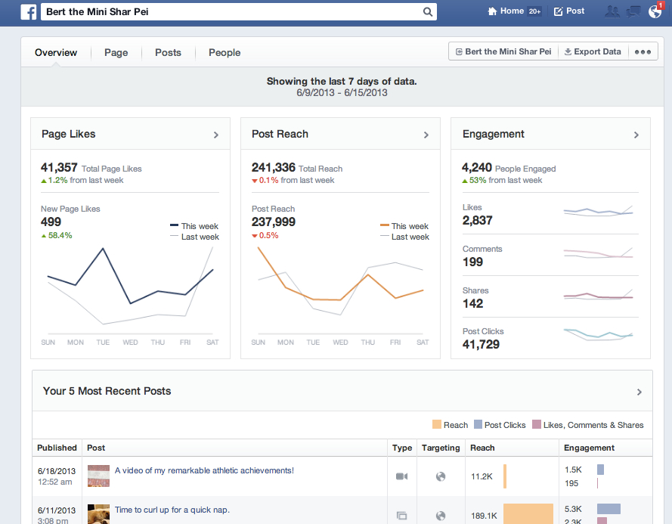
FACEBOOK INSIGHTS
Robust analytics for your business page.
Get a pulse on your audience.
Use insights to make future posts more effective!
Notes:
A powerful, free tool that tracks user interaction on a business account’s Facebook page. With this tool, you can better understand page and post performance, see how people are connecting with your page, and how to make future posts more effective and appropriate for your audience.
Dustin

Slide 51
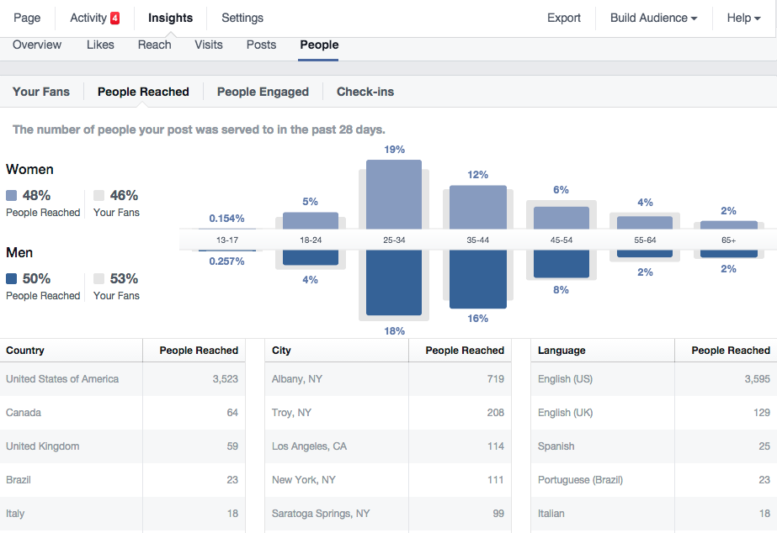
FACEBOOK INSIGHTS
Insights on posts, audience, and page.
Track paid campaigns.
Improve engagement.
Notes:
With Facebook Insights, you can determine the best time to post and what content performs best; how people are engaging with your content; target to a customized audience; create ad sets; track page growth; and so much more. Use these insights to adjust your page, grow your audience and improve engagement.
Dustin

Slide 52
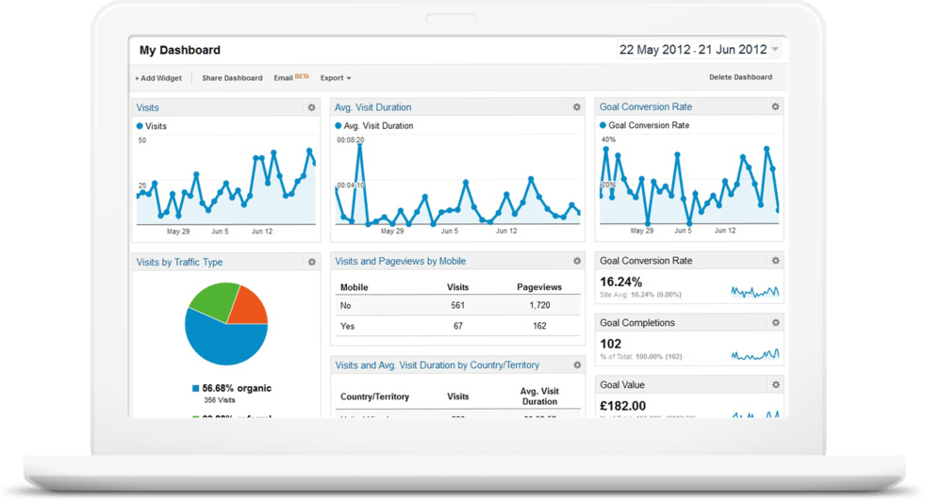
GOOGLE ANALYTICS
Freemium website analytics tool.
Turn insights into action.
Notes:
A Google web analytics service that tracks and reports website traffic. Google Analytics will help you measure site traffic, SEO, engagement, ad revenue, and even activity on social media.
Arianna

Slide 53
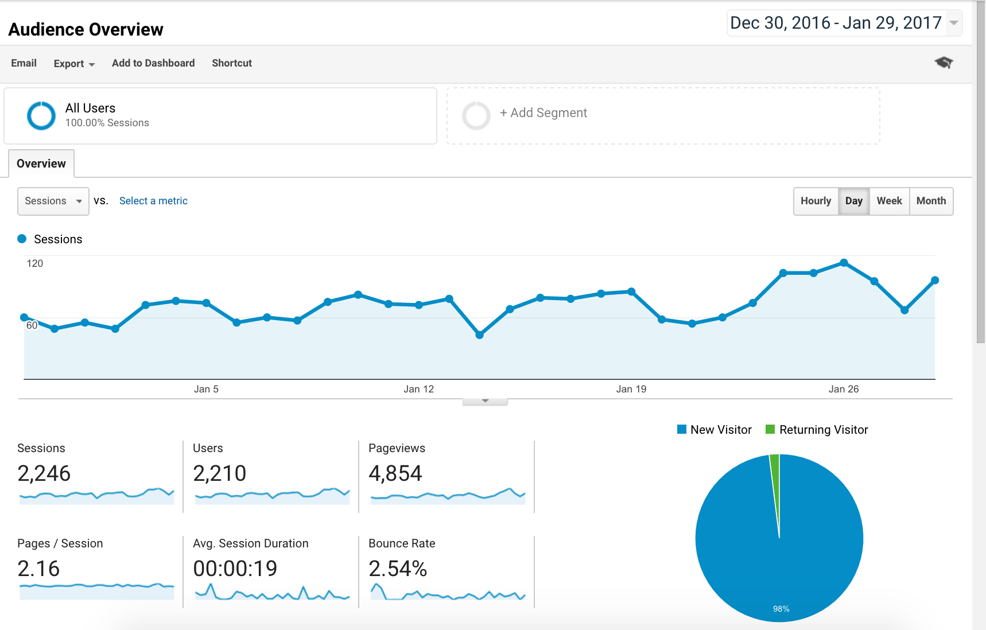
GOOGLE ANALYTICS
Measure website traffic.
Create and track goals.
Sales tracking.
Review online campaigns.
Audience insight and interaction.
Notes:
Whether you run a website for a small business or a large corporation, Google Analytics can be used for tracking, analyzing, and reporting site data so you know more about your visitors and how your pages are doing. It’s easy to use for beginners, and in depth enough for experienced analysts to collect deeper insights.
Arianna

Slide 54
And the Oscar goes to…
FACEBOOK INSIGHTS
Notes:
Arianna - Explain why you <3 FB insights

Slide 55
Notes:
Instead of pizza, we have something even better … answers to your questions!
Dustin

Slide 56
Notes:
That’s a wrap y’all.
Thank you’s all around

Slide 57
DON’T FORGET…
Boiled Down – Podcast series on about challenges, opportunities and successes in the world of Oregon hospitality.
Oregon Governor’s Conference on Tourism (Salem, May 10-12)

