Slide 1
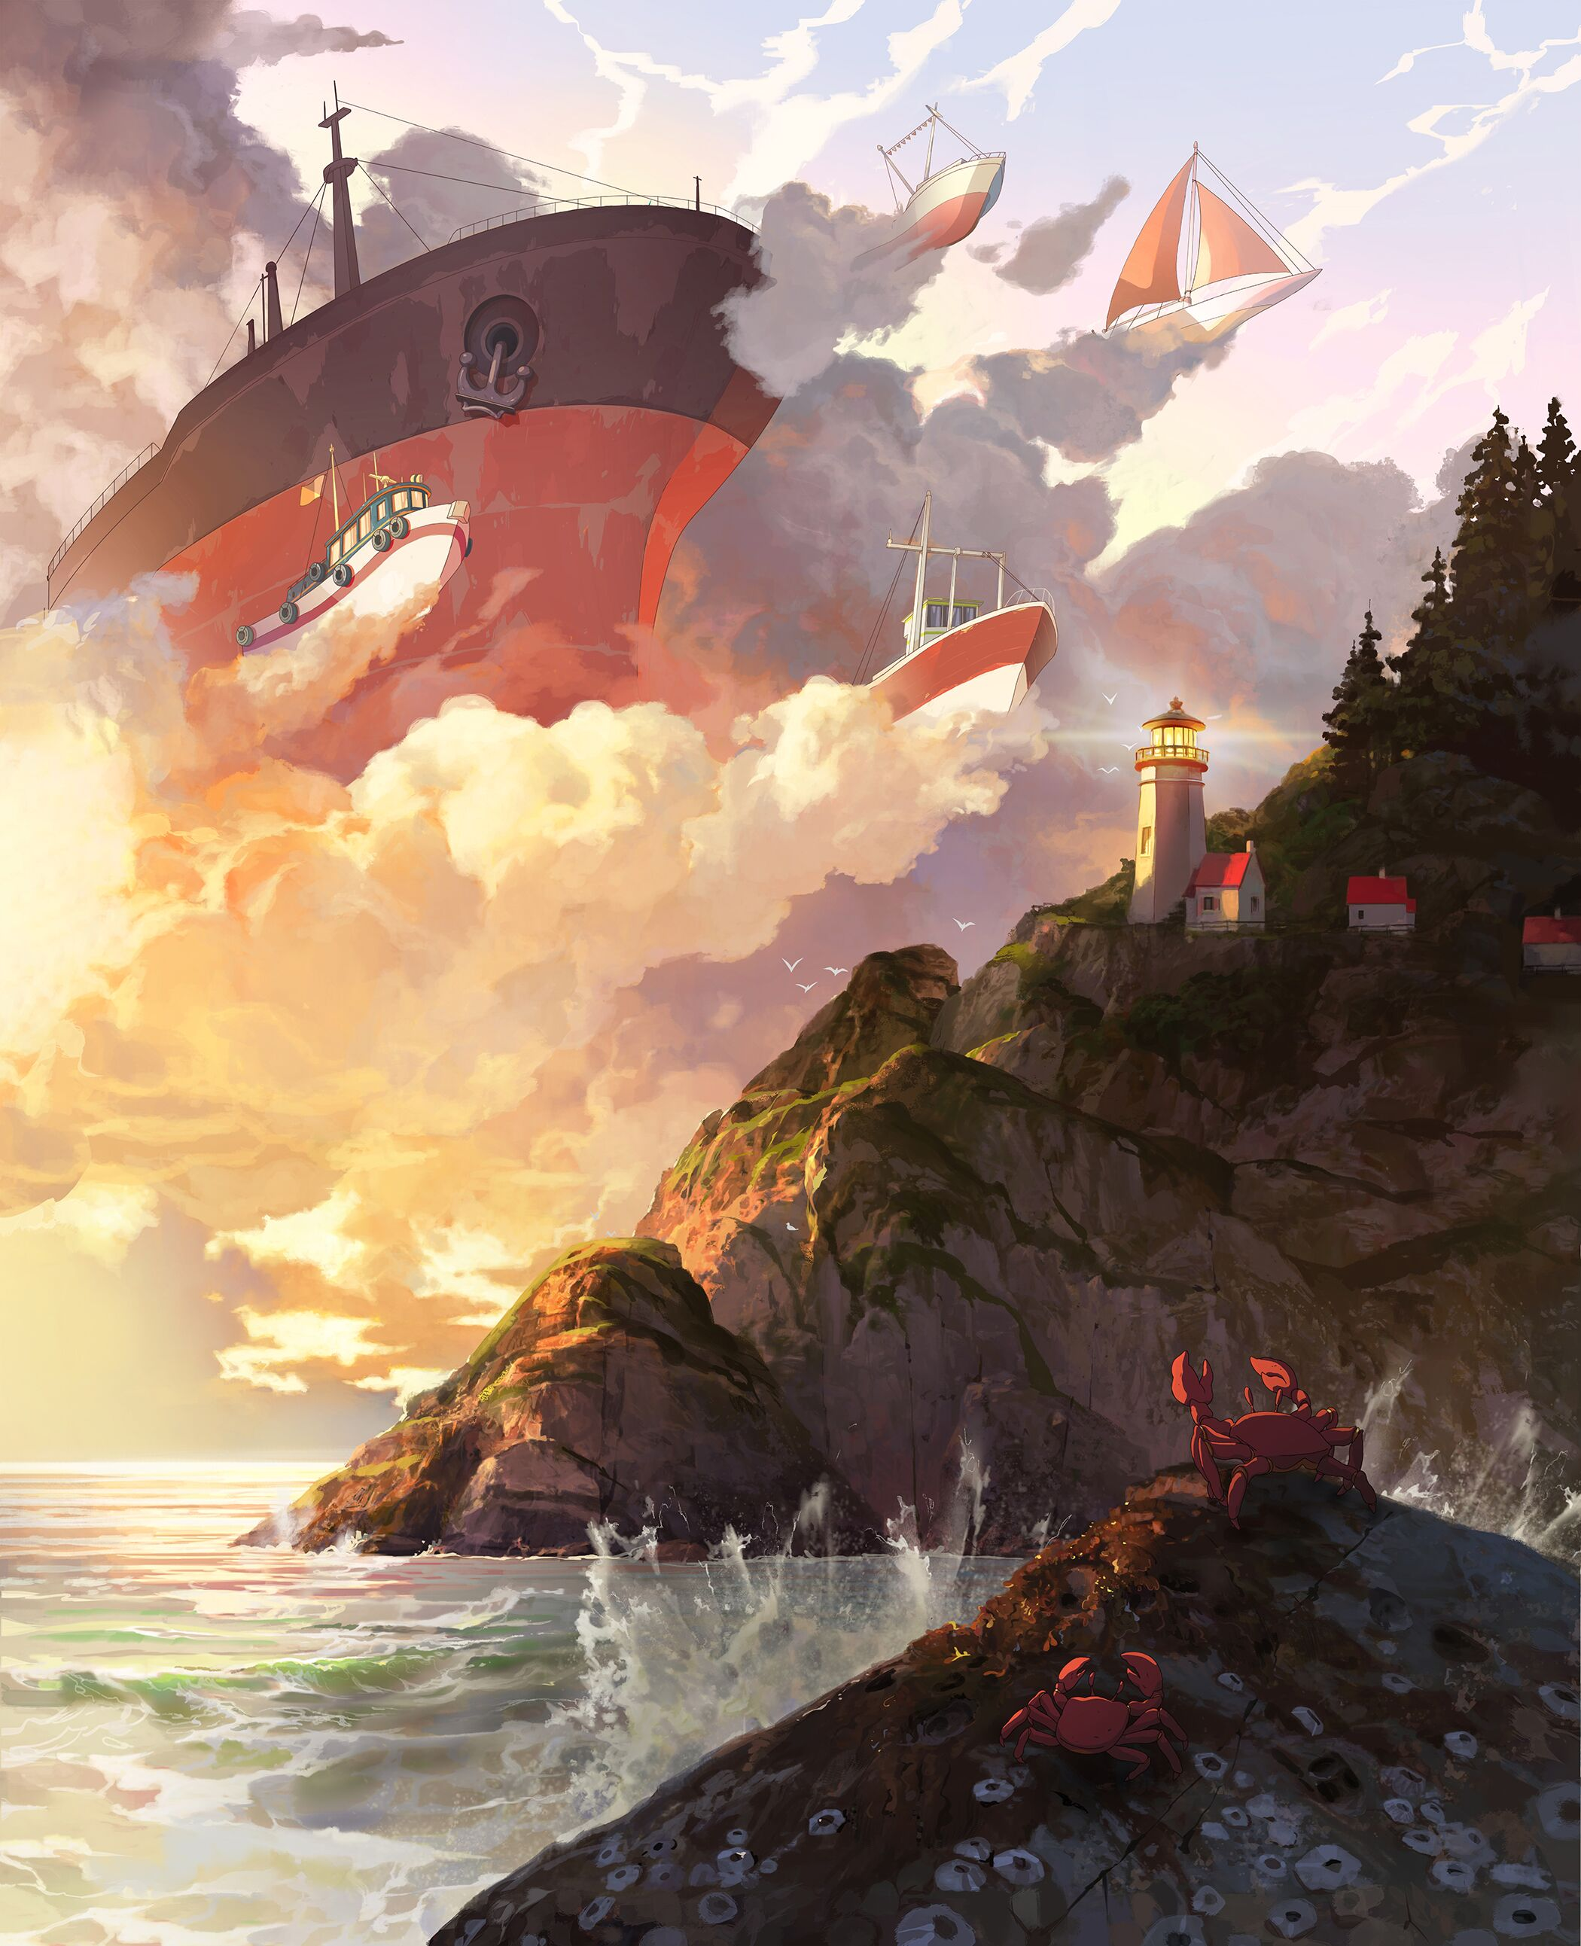
TRAVEL OREGON
FALL/WINTER 2019 MEDIA RECOMMENDATION
9/30/19

Slide 2
PARAMETERS
FLIGHTING
  10/15/19 – 1/1/20
MARKETS
  Primary: Portland
  Secondary: Seattle, Boise, Eugene & Bend
TARGET
  The Winter Wanderer
    Adventurists, in all seasons
    Foodies & beer enthusiasts
    Oregon lover
  Buying Demo: A25-54
ASSETS
  Printed Book
  Out of Home (OOH) Billboards & Transit
  Display Banners
2

Slide 3
COMMUNICATIONS APPROACH
Inspire Oregonians and nearby drive markets to explore Oregon this winter by leveraging the continued success of Only Slightly Exaggerated through the Yeti & Squatch story
OBJECTIVES & STRATEGIES
MEDIA OBJECTIVE
  Promote winter-time travel around Oregon with the Yeti & Squatch Illustrated story. Generate excitement and engagement by following the story week-by-week, culminating the campaign with the book release.
MEDIA STRATEGIES
  Inspire: Align with key community media partners to capture local interest and drive engagement
  Activate: Bring our audience through the Yeti & Squatch journey, using the completed book as a reward for active followers.
  Convert: Re-enforce message with lower funnel tactics to drive bookings.
3

Slide 4
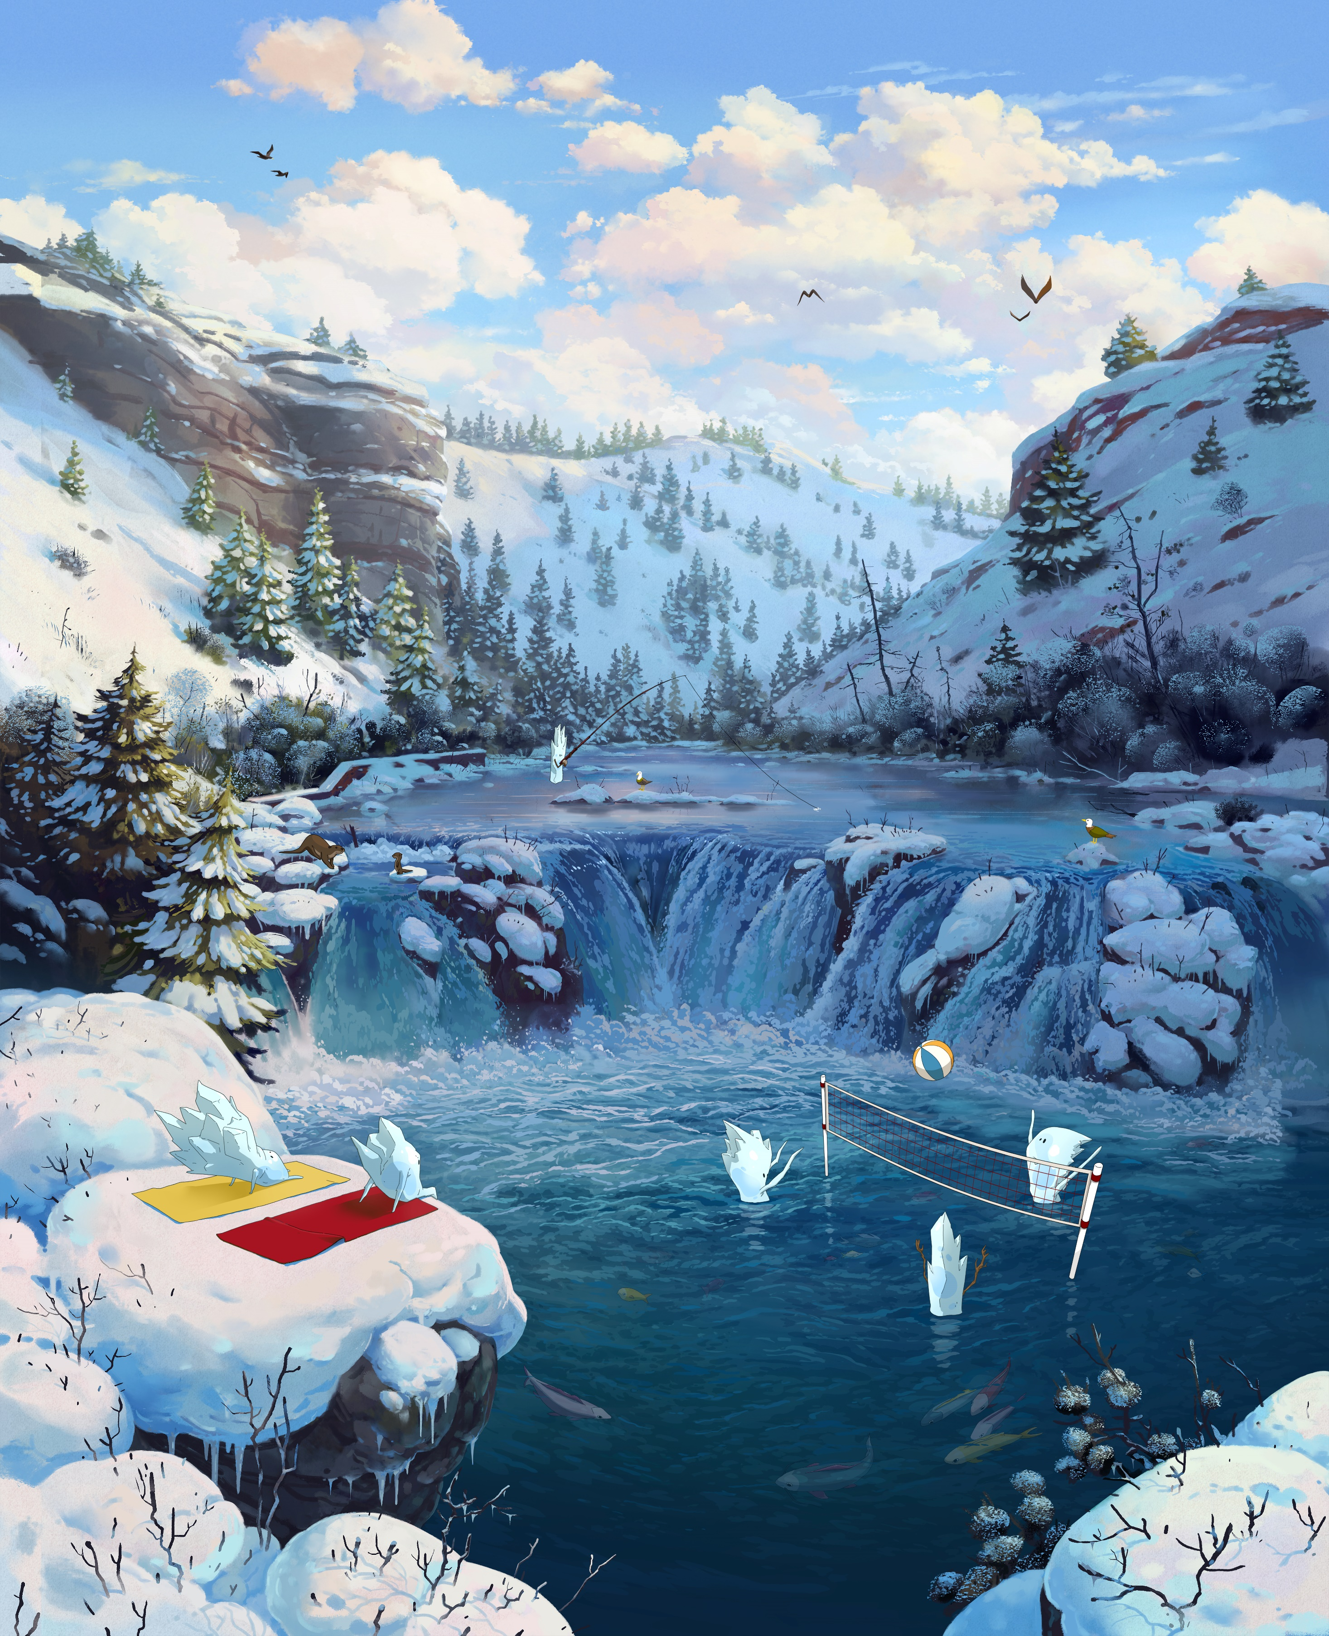
MEDIA DETAILS

Slide 5
CUSTOM CONTENT PARTNERSHIP
HIGHLIGHTS
  Re-approach custom content this winter by creating multi-faceted plans that work to not only drive traffic to TO.com, but also engage potential visitors and promote the book
    Tap into Portland Monthly’s familiar local voice to roll-out the Yeti & Squatch story on a weekly basis
    Leverage Travel & Leisure’s national recognition to inspire travelers with premium editorial and drive awareness for the book
10

Slide 6
OUT OF HOME (OOH)
HIGHLIGHTS
  Create excitement about the Yeti's & Squatch's Oregon adventures with high impact OOH units in Portland
7

Slide 7
DIGITAL DISPLAY
HIGHLIGHTS
  Increased spend dedicated to digital display by 343% YOY to drive traffic to TO.com and encourage engagement with campaign content
  Update rotation weekly to feature regional roll-out of creative
8

Slide 8
ONLINE TRAVEL AGENCY (OTA)
HIGHLIGHTS
  Connect with our target while they are in currently in the travel mind state, when they are most likely to book
  Continue to invest in OTAs at similar spend level as these partners are proven booking drivers
11

Slide 9
SOCIAL MEDIA
HIGHLIGHTS
  Drive awareness of the campaign and the Oregon Winter product
  Drive traffic to TO.com to promote the campaign-related content
  Drive Video views promoting the campaign book and Oregon Winter product
12

Slide 10
KEYWORD SEARCH
HIGHLIGHTS
  Drive deeper funnel clicks to targeted landing pages on TravelOregon.com
  Capture interest of winter-related keywords
12

Slide 11
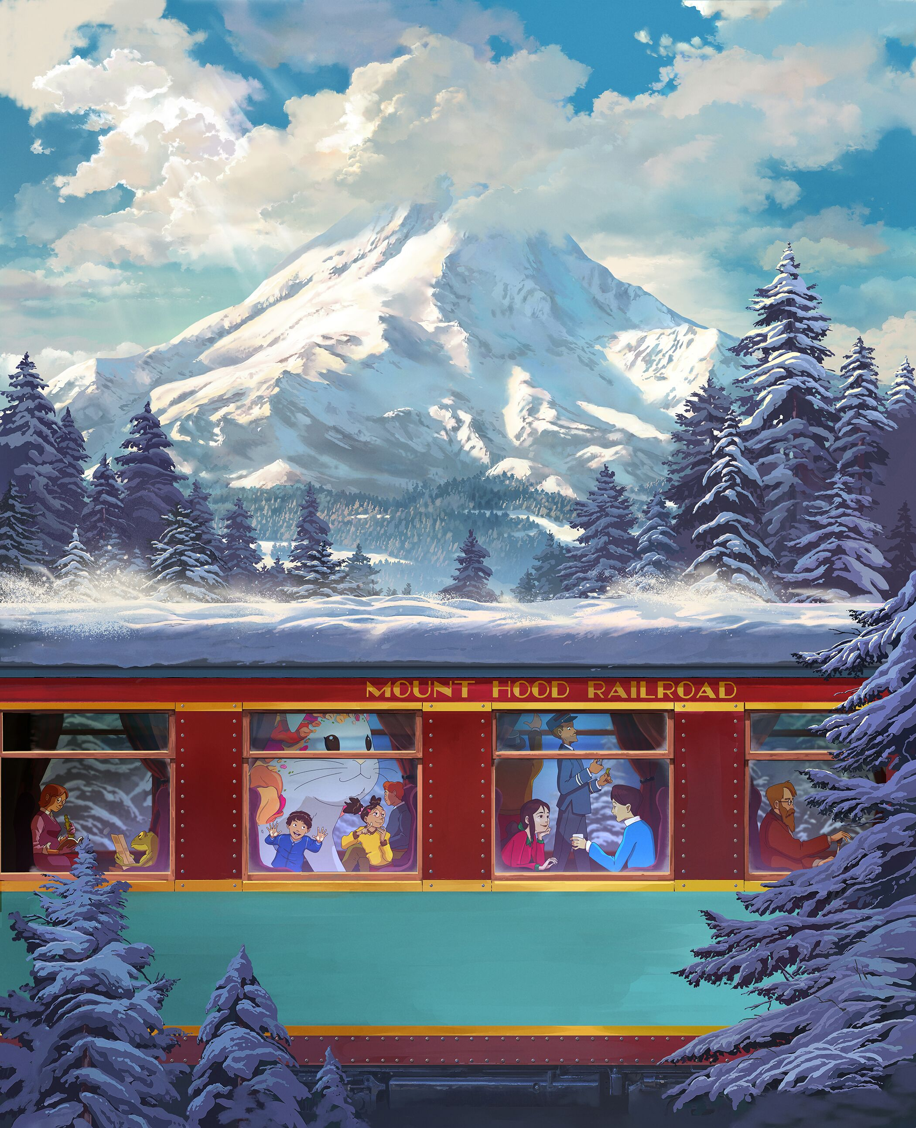
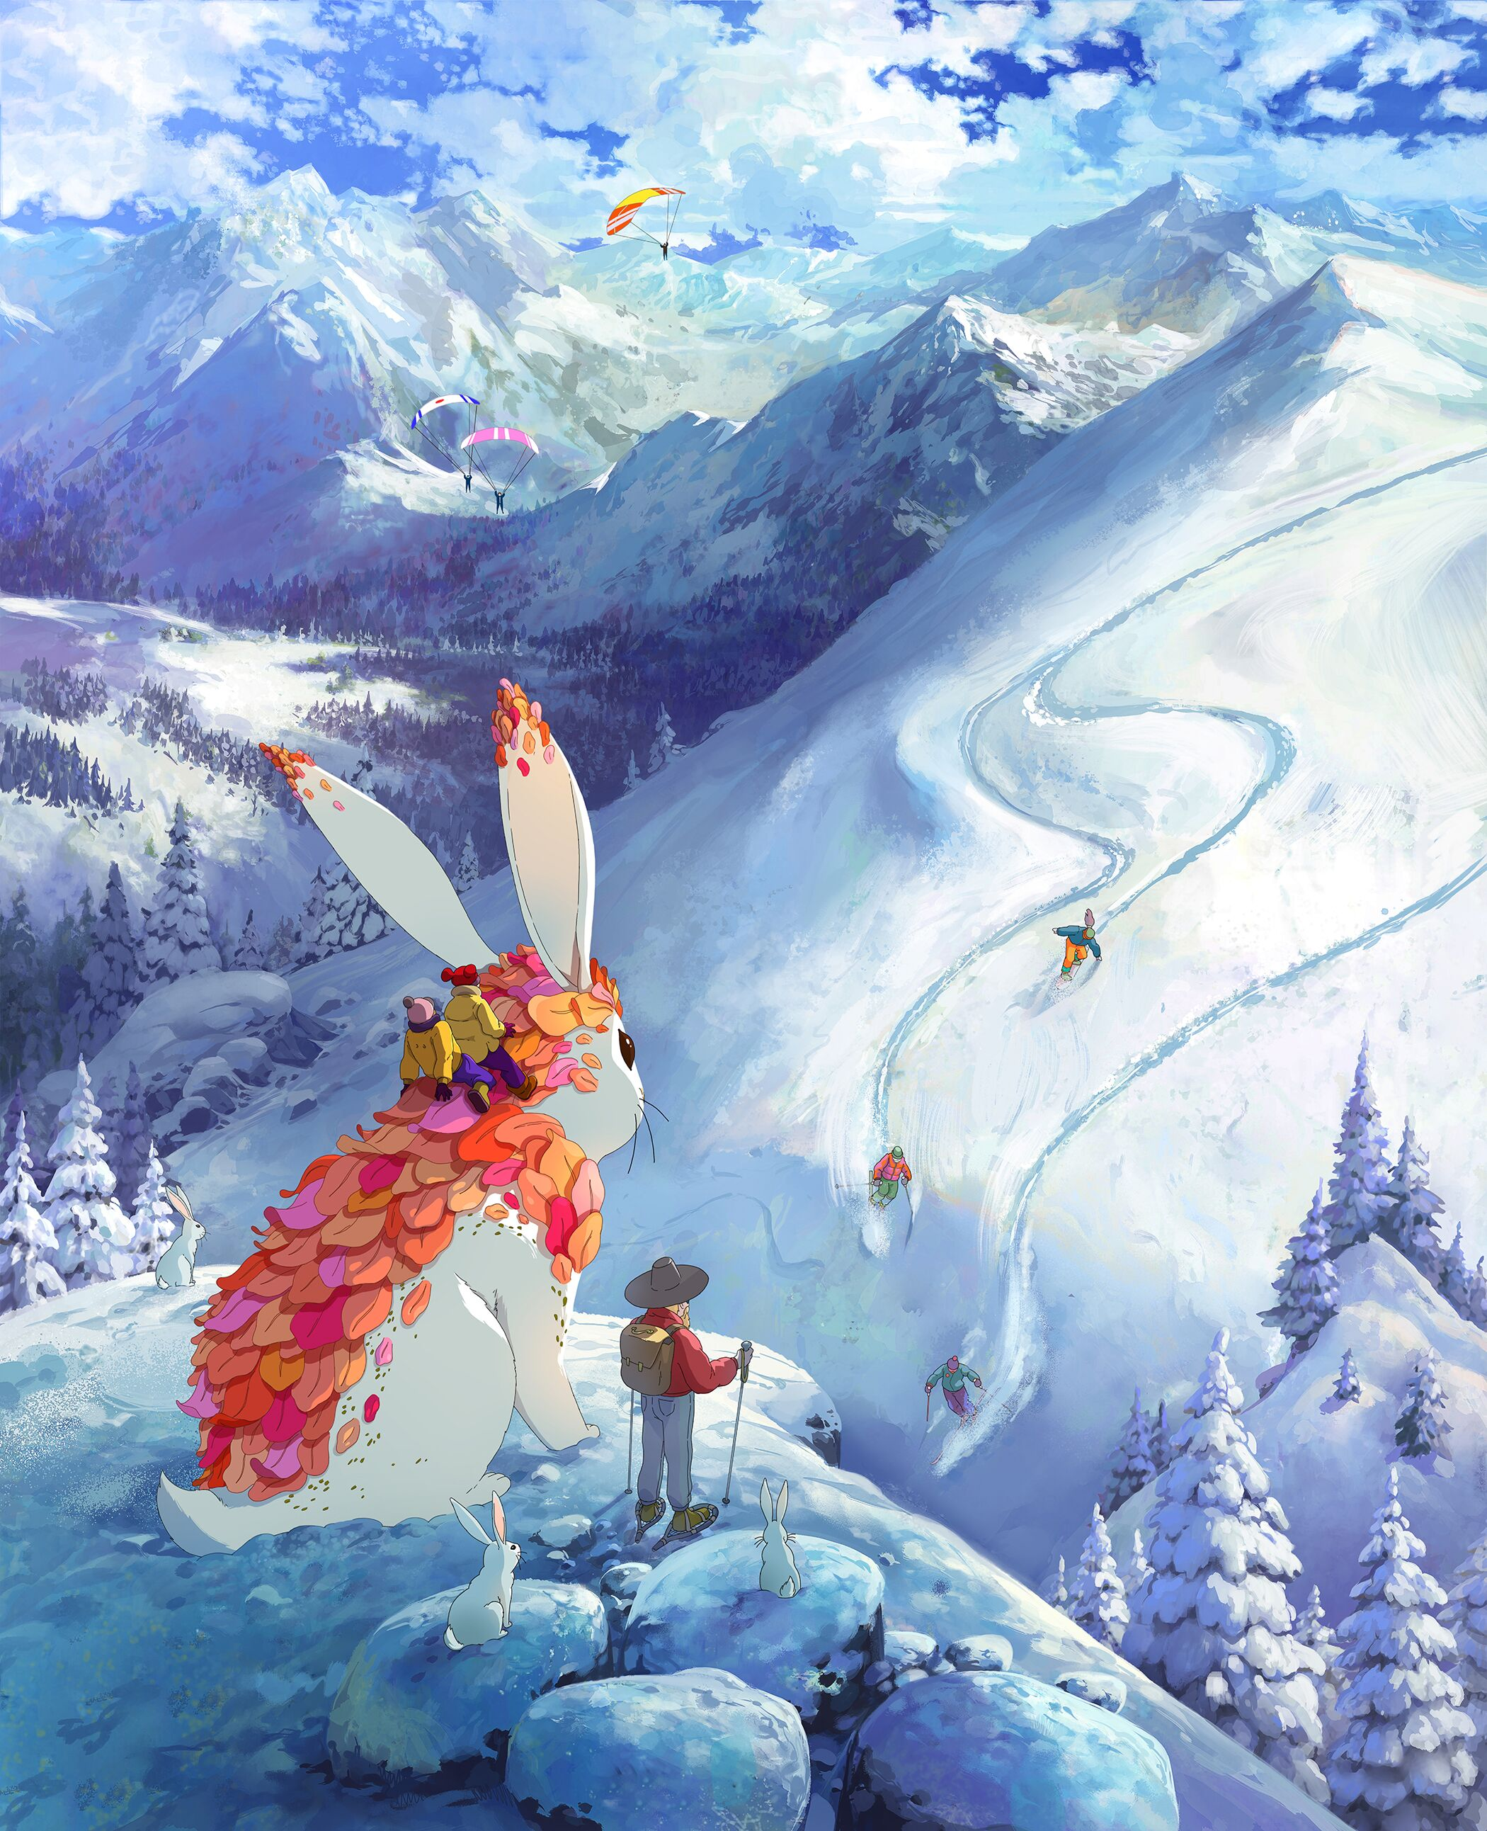
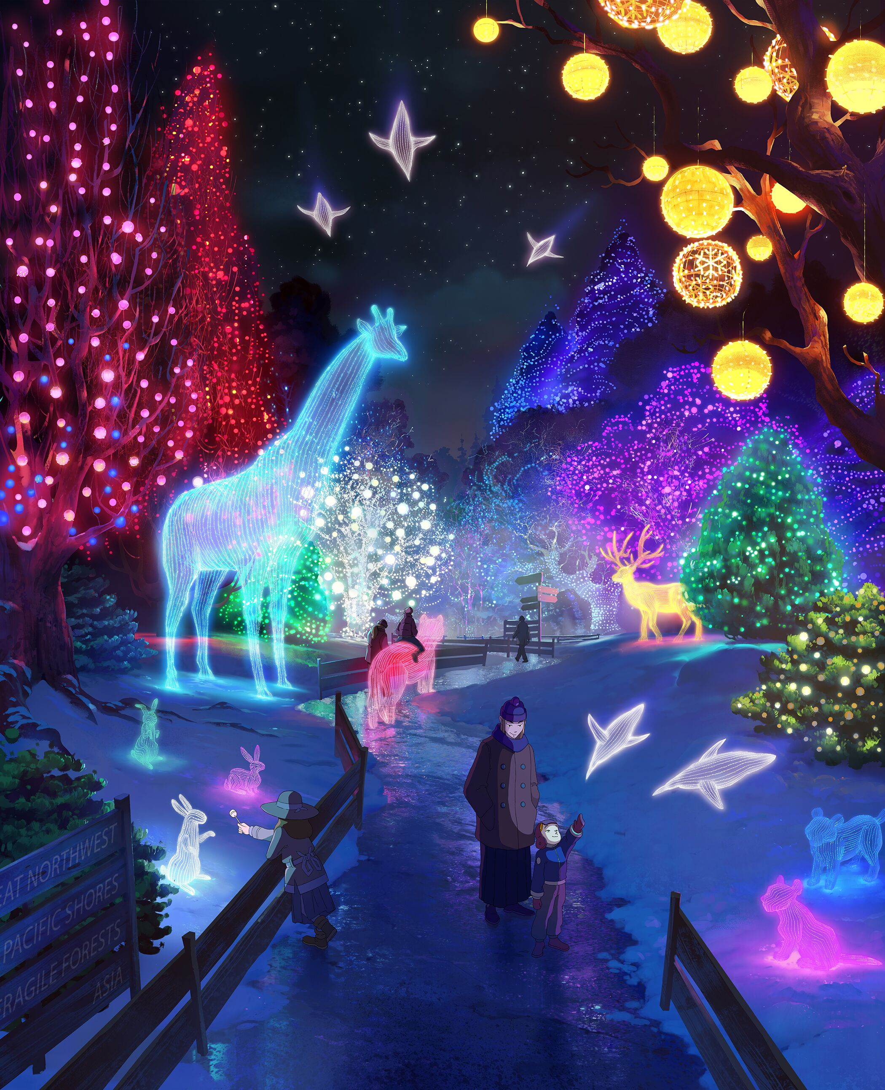
THANK YOU

