Slide 1
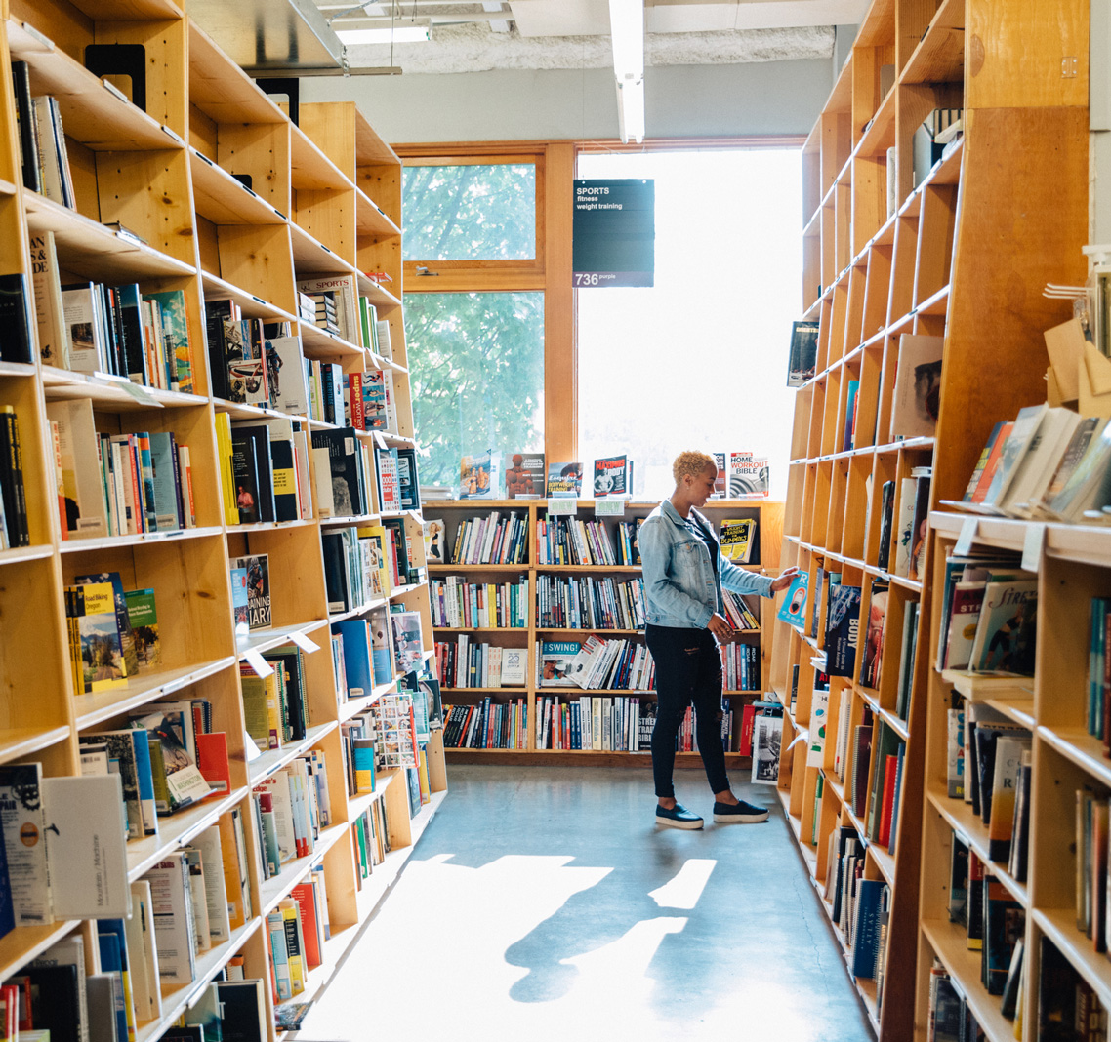
HOW TO USE
THIS DECK
In collaboration with Miles Partnership and Locl, Travel Oregon has curated several informational slides you might find helpful.
While some slides (like this one) will appear Travel Oregon-branded, this deck is a bit of a hodge-podge. You do not need to co-brand any of these slides.
If you have questions, don’t hesitate to get in touch: integrated@traveloregon.com.

Slide 2
GOOGLE BUSINESS PROFILE FUNDAMENTALS
Brought to you by:
Travel Oregon & [DMO NAME]
Your DMO Logo Here

Slide 3
Why is this important?

Slide 4
>90%
Nearly half of these searches
are local in nature.²
of internet searches happen
in Google¹
Notes:
1m
Google = THE most important channel.
What local in nature means is that you’re conducting a web search based on a qualifier like ‘Near Me’ or my city or zip code. (e.g. nearby, local qualifiers like city, state, zip, etc.)

Slide 5
Your Google Business Profile is the single most significant source of organic exposure for your business online.

Slide 6
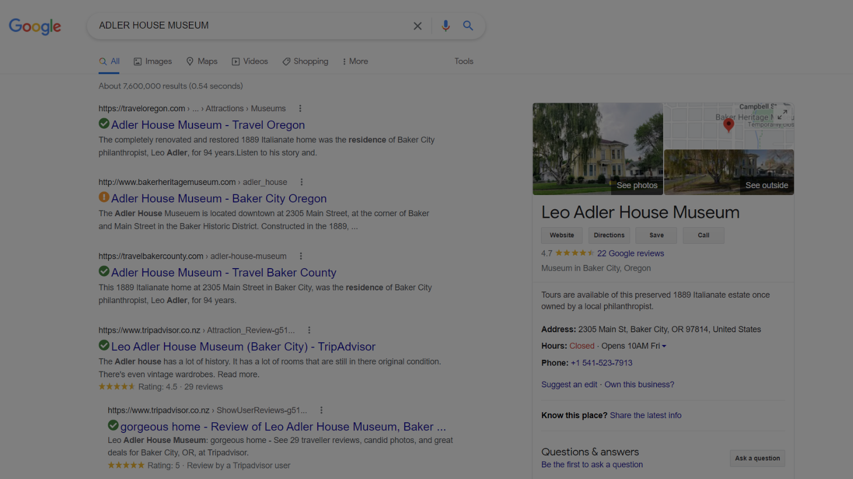
Wait… what’s a Business Profile?
Business Profile in SERP (Search Engine Results Page)
Example of a Google Business Profile “card” for a local business.

Slide 7
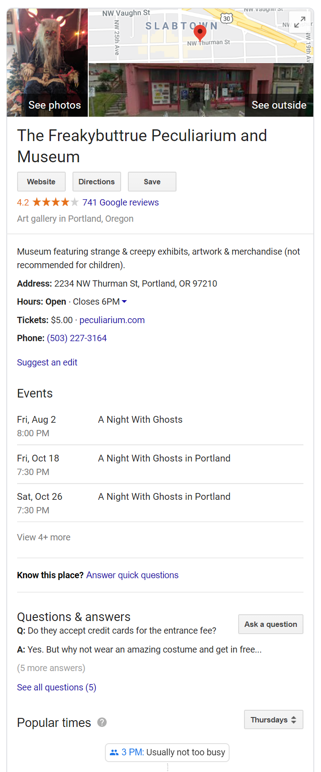
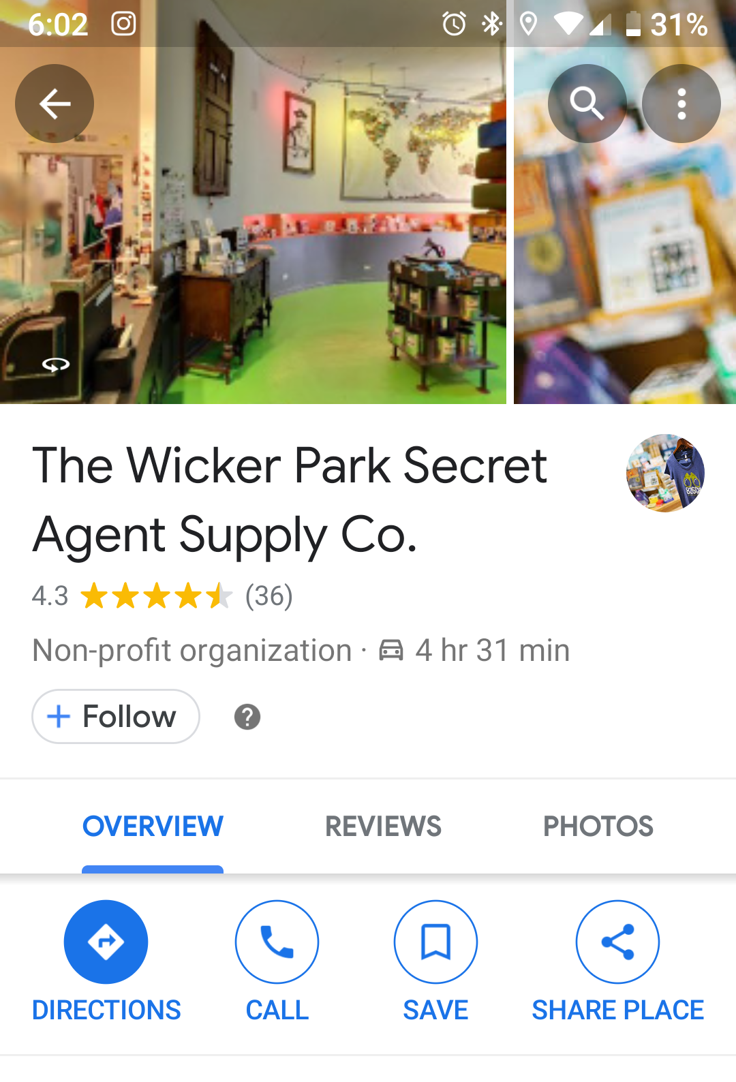
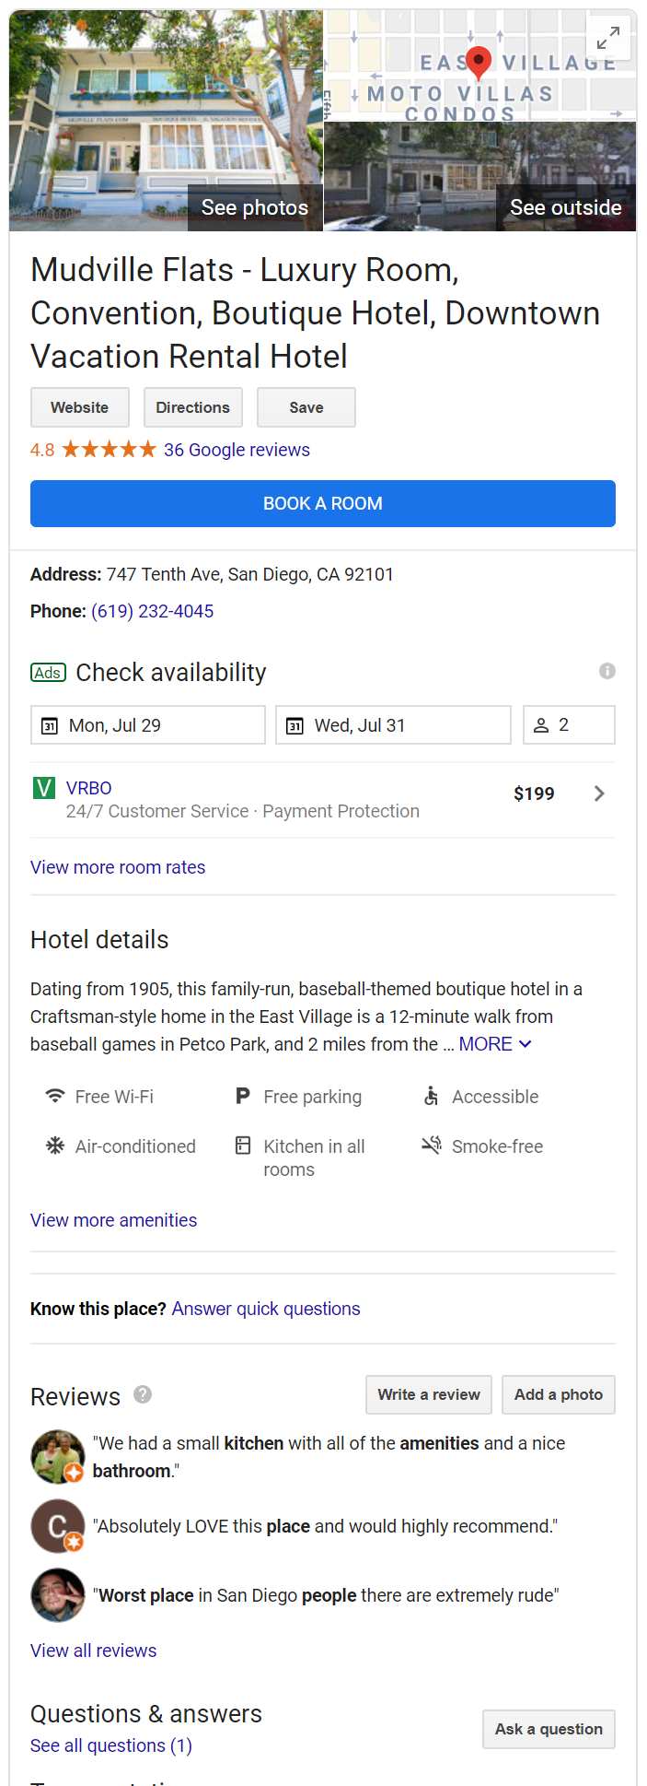
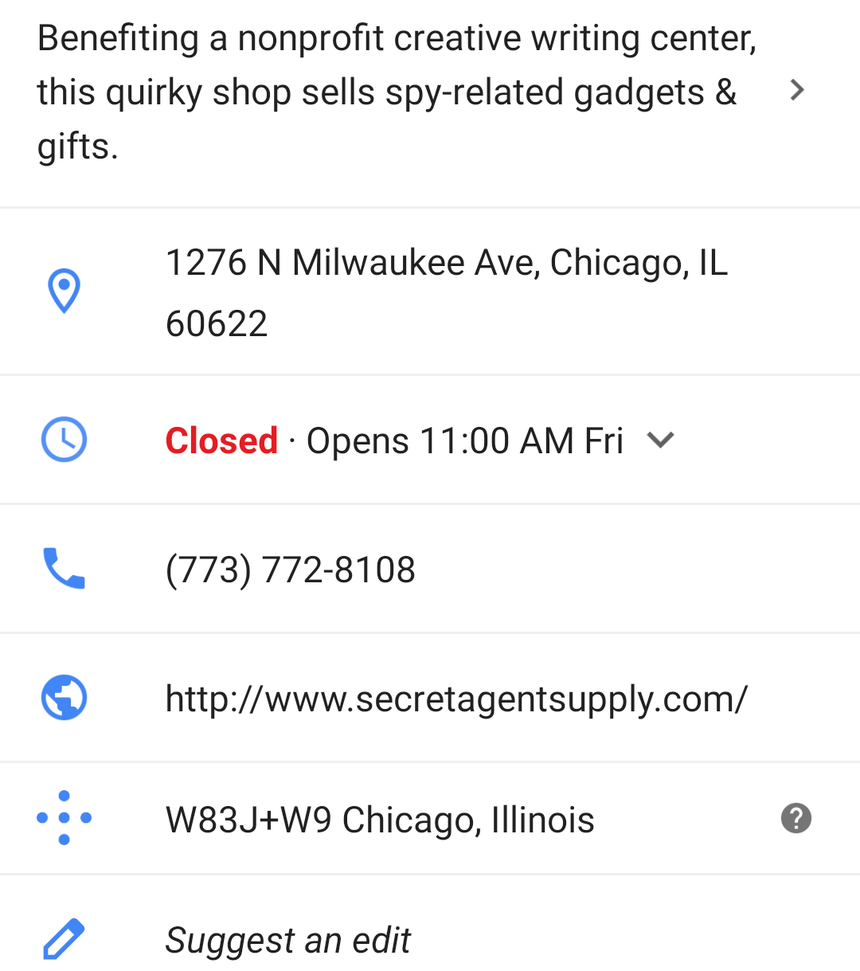
Business Profiles appear throughout the Google Ecosystem and aggregate everything Google knows about your business.

Slide 8
Google reports local search delivers over 4 BILLION direct connections for businesses every month.

Slide 9
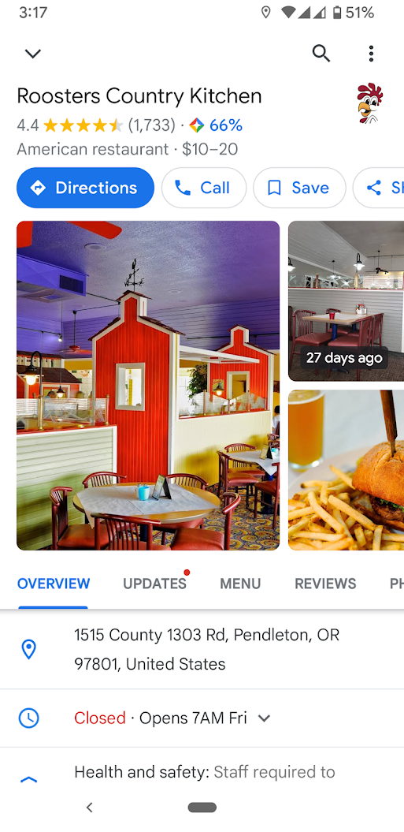
Your Google Business Profile is the first thing people see about your business when they search

Slide 10
Up-to-date profiles are:
2.7x more likely to be considered reputable.¹
70% more likely to attract location visits.¹
50% more likely to lead to a purchase.¹
⁽¹⁾ Ipsos research: Benefits of a complete listing 2017

Slide 11
Three Fundamentals
Google Business Profiles

Slide 12
Hours are critical
Searches for “open now” have skyrocketed over the last 2 years
300% increase in search for “open now” and 200% increase in searches for “open now near me”
3X

Slide 13
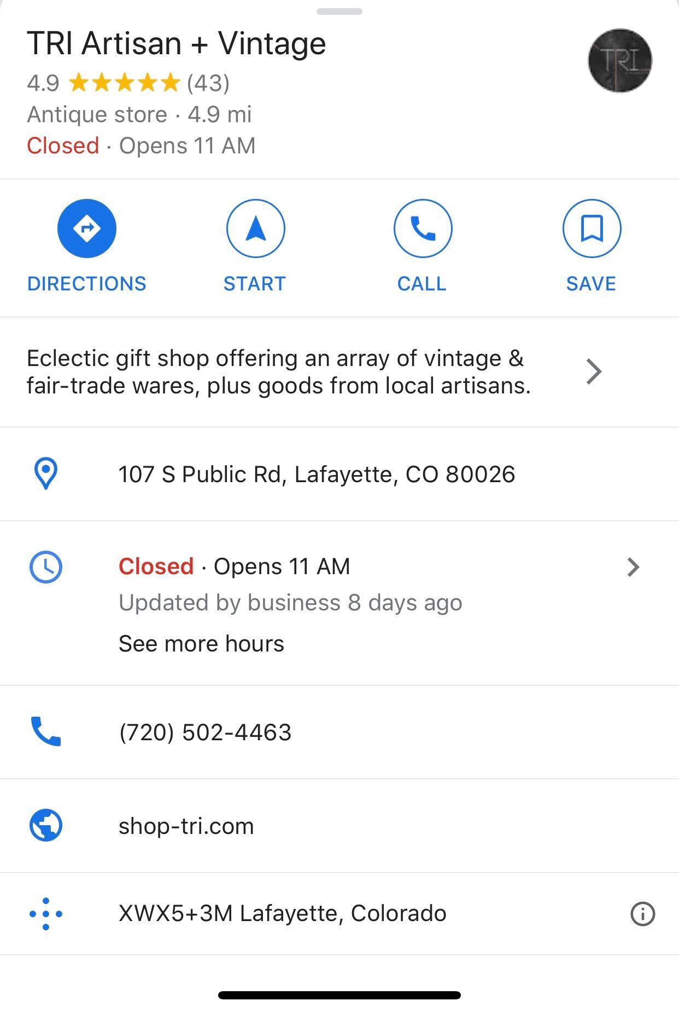
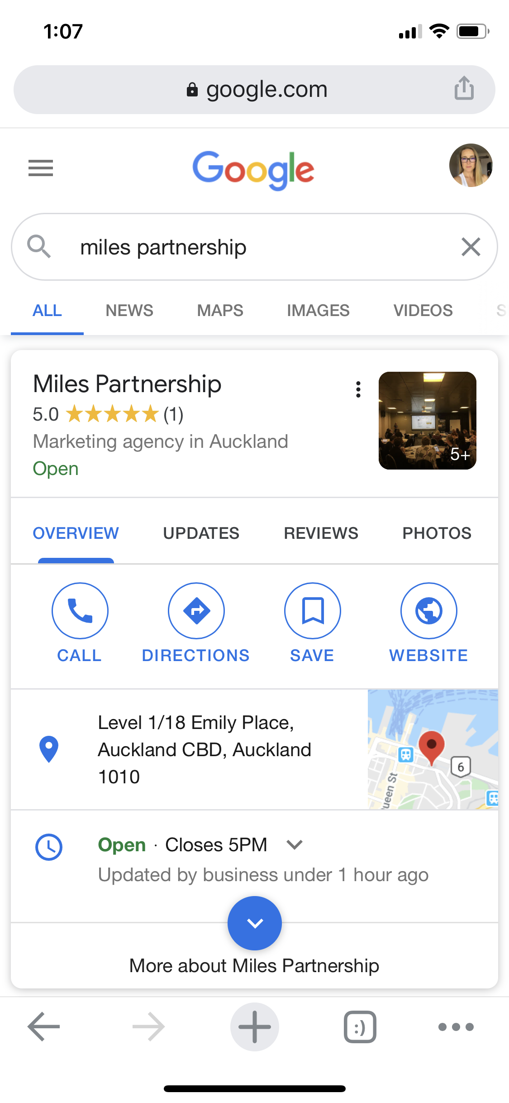
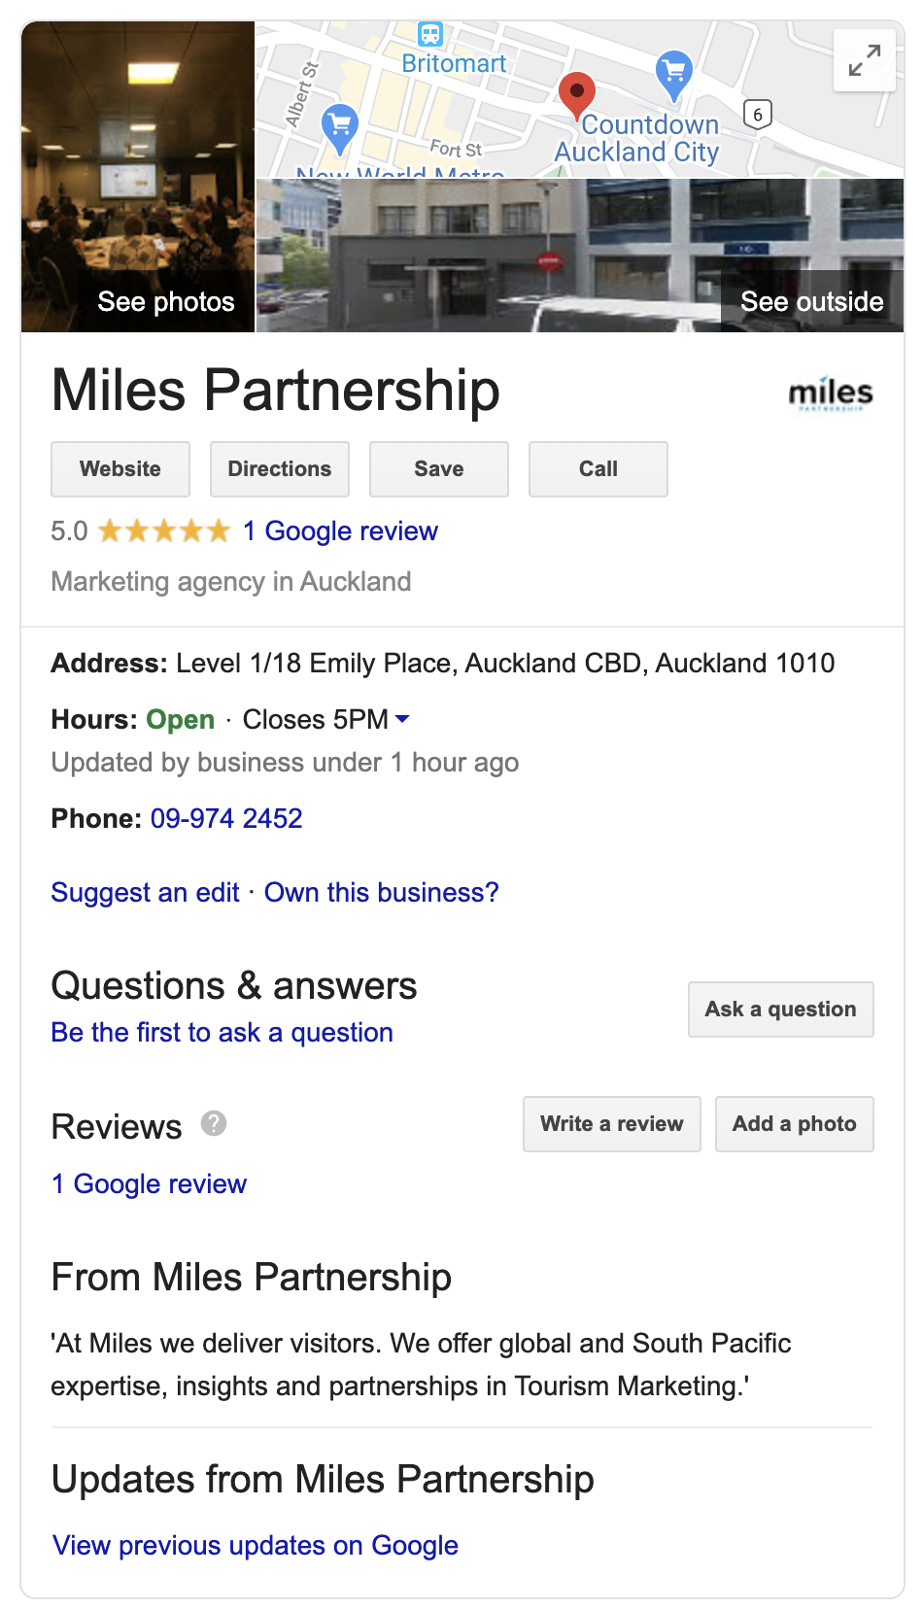
Hours last updated

Slide 14
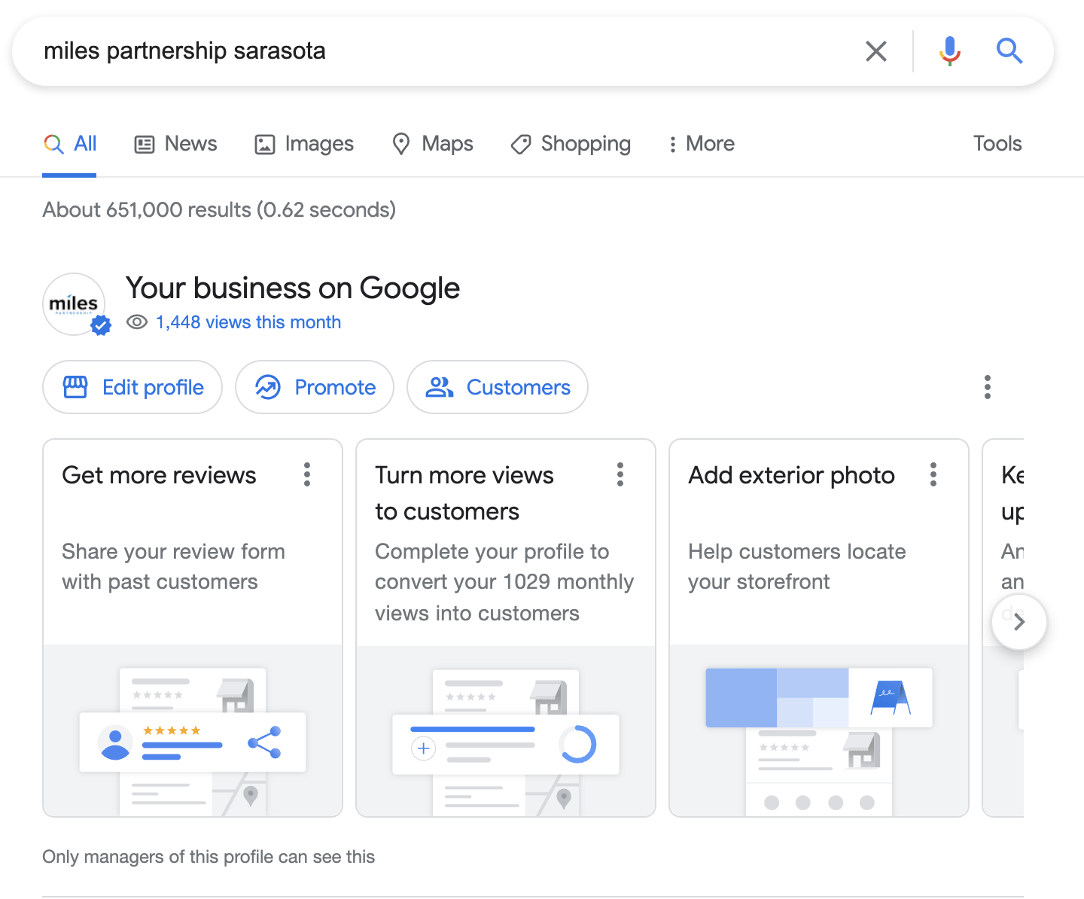
Edit Hours
In the SERP, search for your business and go to edit profile.

Slide 15
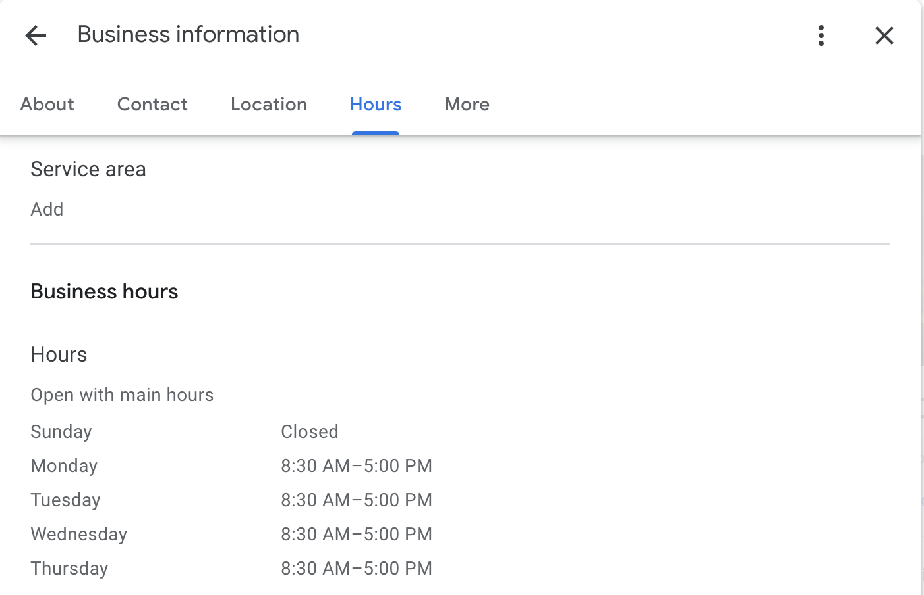
Edit Hours
Hours and “open now” are the most frequent customer searches for a business.
Keep regular daily hours up-to-date under Business hours.

Slide 16
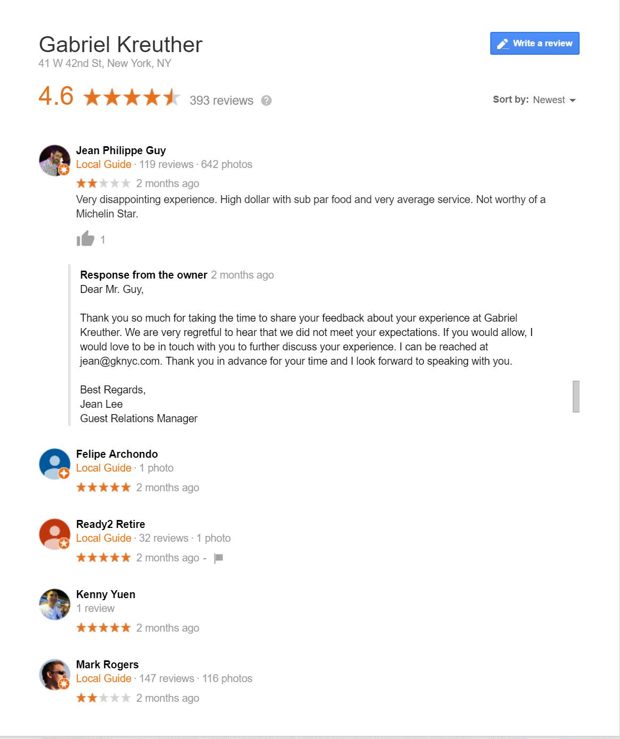
2. Respond to Reviews
Customer reviews are posted by users directly to your Google Business Profile. They appear wherever your profile appears, and are the source of your “star rating”

Slide 17
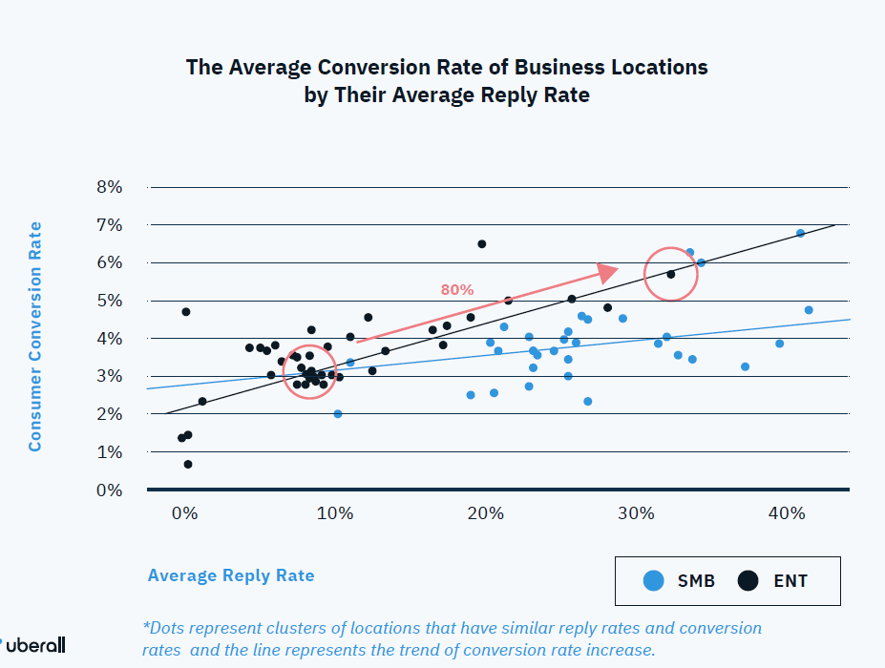
2. Respond to Reviews
Respond to 30% of your reviews for an 80% boost in conversions. Responses show you are attentive to customers.
https://uberall.com/en-us/company/press-releases/study-brick-and-mortar-businesses-small-increase-in-online-ratings-boosts-conversion-by-25-percent

Slide 18
Responding to reviews
Instead of “Edit profile” select “Customers” on the SERP profile edit box.

Slide 19
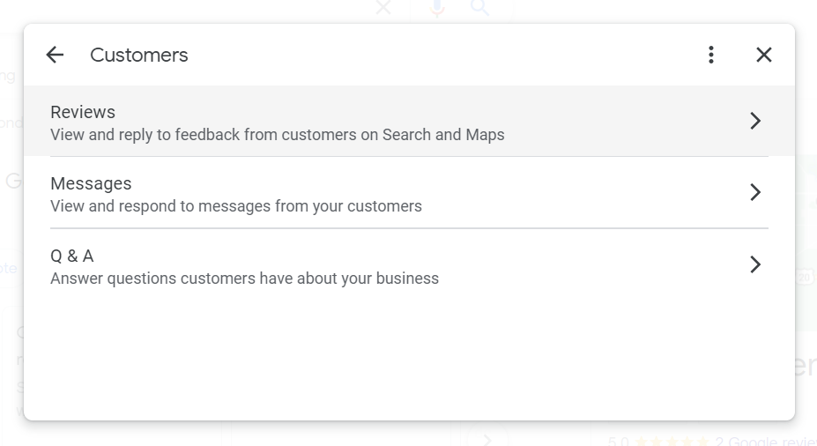
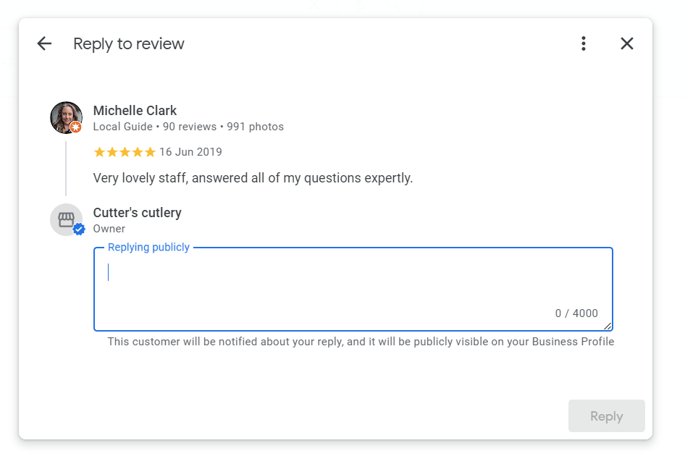
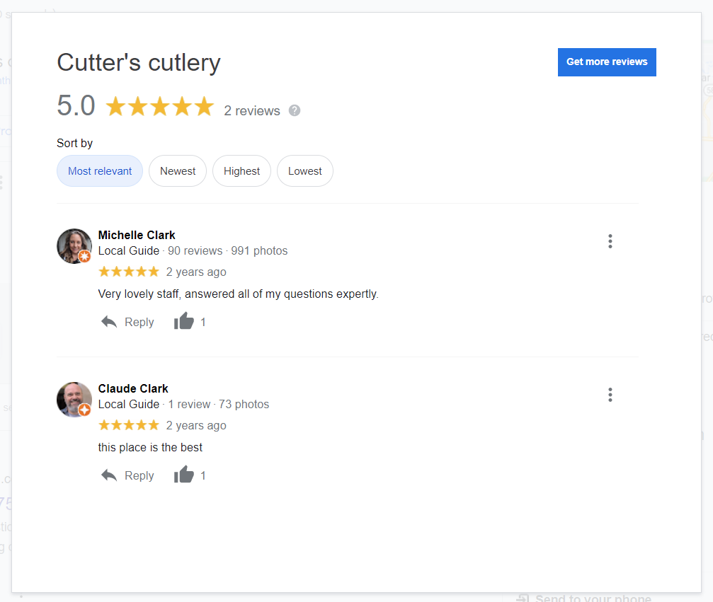
Responding to reviews

Slide 20
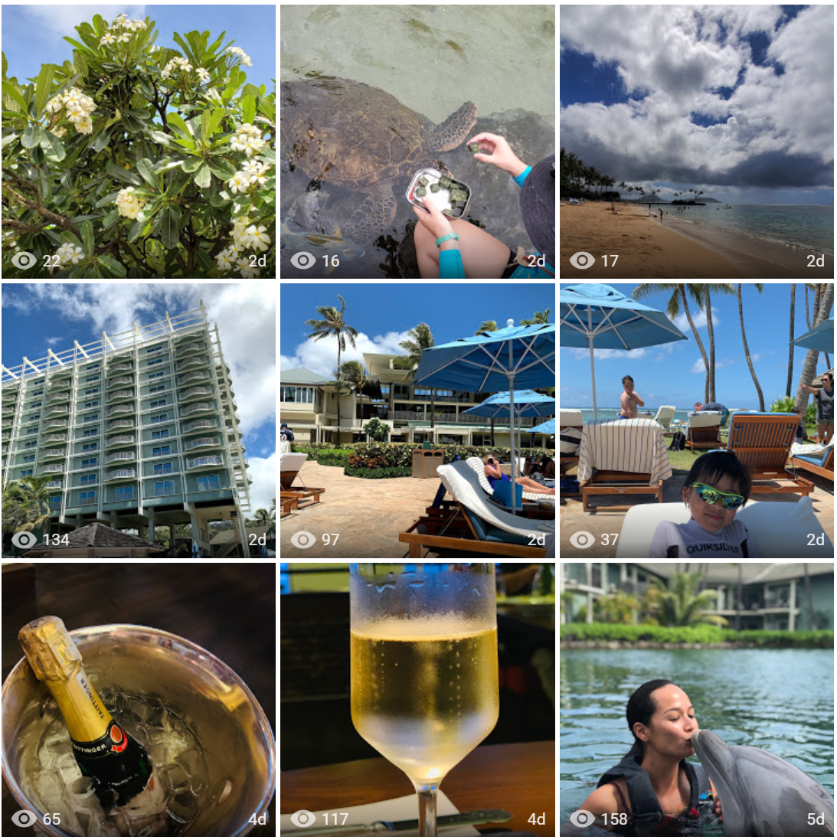
3. Upload 4 photos a month
Photos are a key part of how potential customers make decisions about your business.

Slide 21
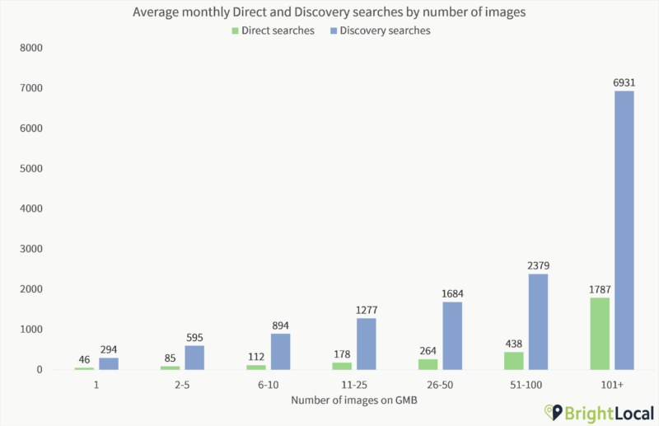
3. Upload 4 photos a month
Businesses with more than 100 images have significantly higher exposure rates.
291%
Higher exposure
https://searchengineland.com/new-research-shows-strong-link-between-google-my-business-photo-quantity-and-search-performance-320199

Slide 22
3. Upload 4 photos a month
Businesses with more than 100 images have significantly higher exposure rates.
Add 4-5 photos per month for a
10-30%
Lift in exposures for your business
291%
Higher exposure
https://searchengineland.com/new-research-shows-strong-link-between-google-my-business-photo-quantity-and-search-performance-320199

Slide 23
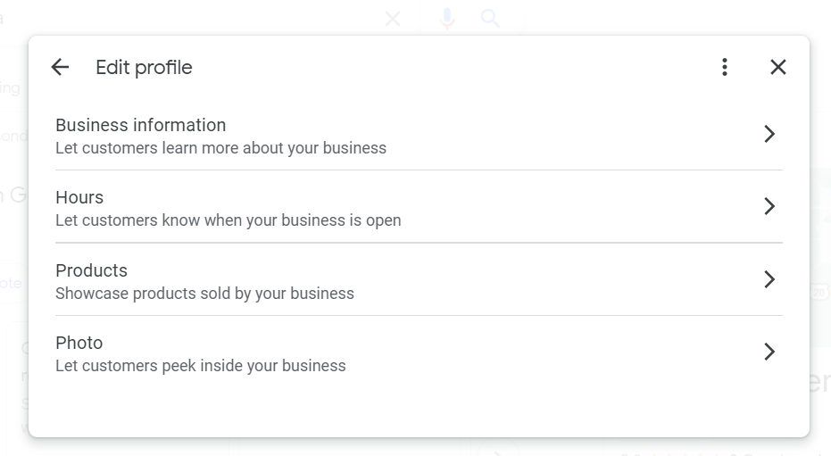
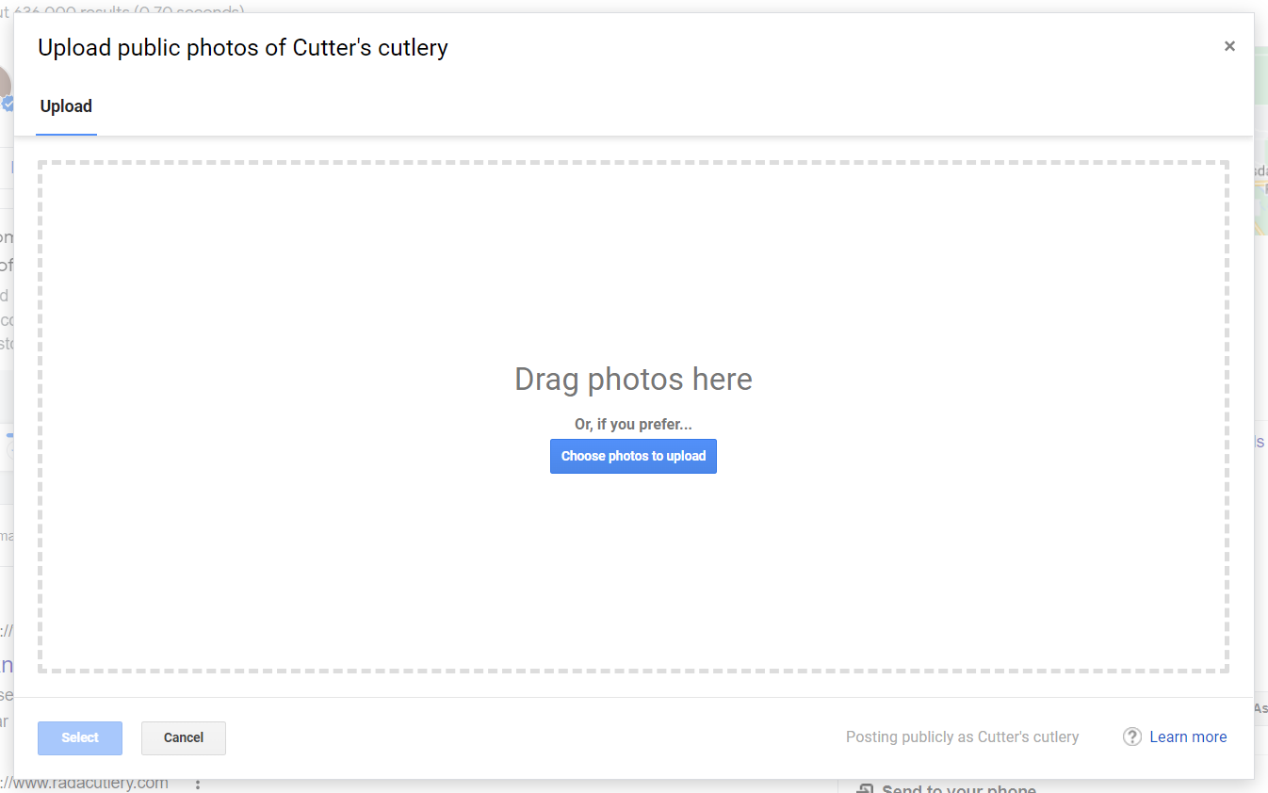
Add photos
Back to “Edit Profile” but select “Photo” option this time. Drag and drop or upload images.

Slide 24
Three Fundamentals
Up to date hours are critical
Respond to 30% of your reviews for an 80% lift in conversions
Post 4 photos a month for a 30% lift in exposure

Slide 25
MAXIMIZE WITH LOCL

Slide 26
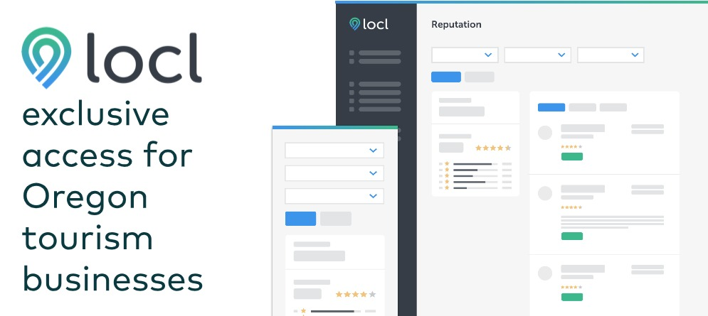
If you’re thinking that this sounds like a lot to manage - you’re right!
That’s why Travel Oregon has teamed up with Oregon-based company, Locl, to offer you a free way to manage and maximize your Google My Business profile without all the clutter.
+

Slide 27
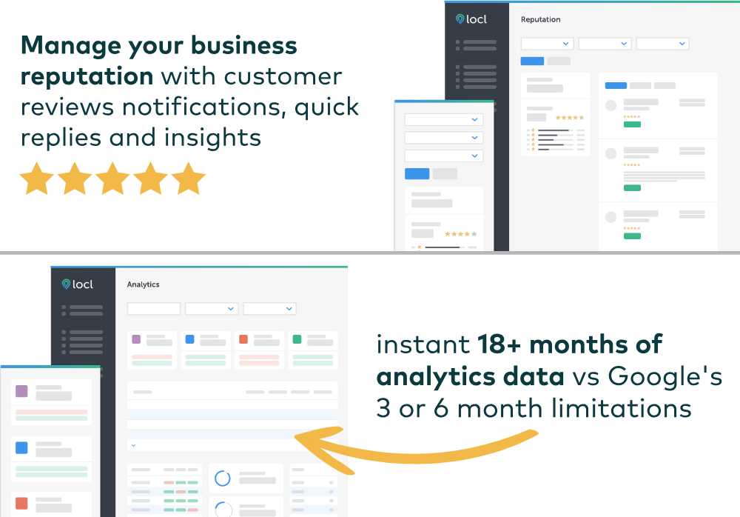
Notes:
Locl Update (5m):
Before we dive in, I want to ground us in a bit of context. When we embarked on this partnership, the economic outlook for our industry was bleak. Mainly due to COVID-19, but also because of disastrous wildfires across the state. Due to compounded crises, many businesses had to significantly alter how, when and where they did business; some businesses closing for extended periods of time, while others never reopened. Events were cancelled, attractions shifted from in person to online and restaurants provided takeout only options. As you can imagine, a web presence was a vital lifeline for the entire service industry (and consumers!) at that time. And while we’ve come a long way over the past couple years, the importance of having an accurate, online presence is just as vital as it ever was.
You’ve probably heard this stat already, but let me say it again: Google accounts for over 90% of online searches and a complete and accurate Google Business Profile (GBP) is 70% more likely to bring a customer to a business. We also know that businesses that consistently engage with reviews, refresh photos and keep their listings accurate not only build trust with customers, but also contribute to the overall vibrancy of a destination.
To give Oregon tourism businesses a competitive edge and help aid in recovery, we partnered with Portland-based company, Locl.
Locl provides businesses with easy-to-use tools and resources that simplify and streamline updates to high visibility platforms like Google, via Google Business Profiles (GBP). Using Locl, businesses can quickly update location information and photos, post offers and events, engage with customers, monitor business performance and act on insights – all in one place and for every location.
Inspired by our friends at Travel Portland, we are providing tourism-related businesses in Oregon access to the Locl platform for free.
What’s more, we are finding new ways to amplify listing management efforts efforts. Beyond pushing updates to Google, those same updates are being imported by OTIS nightly and available for partners to use. We are also excited to be in discussions with Locl about providing Oregon tourism business the ability to push updates from Locl to other high visibility platforms like Facebook, Instagram and Apple Maps. While this is still on the DL, our hope is to unveil it (along with some other sweet upgrades) in the Locl training June.

Slide 28
WITH LOCL YOU GET:
A handy dashboard to manage one or many locations – in the same place
Alerts on Smart To-Do’s
Customer Reviews Center
Manage your posts, offers and events
Timely emails with actionable tips and recommendations
View up to 18+ months of analytics data
Access to real-person support

Slide 29
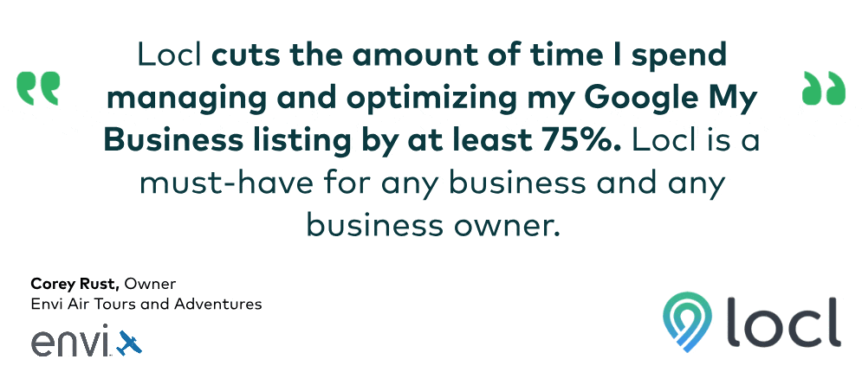

Slide 30
ADDITIONAL
RESOURCES
TEMPLATES, TOOLS AND TRAININGS
Business Listings Toolkit (industry.traveloregon.com/listings)
May 19: GBP Training (industry.traveloregon.com/gbp-may)
June 6: GBP Training (industry.traveloregon.com/gbp-june)
June 23: Locl Training (industry.traveloregon.com/locl-june)
R/DMO Resources (industry.traveloregon.com/listings-dmo)
Locl Registration (locl.io/traveloregon)
Google Business Profile
Notes:
SLIDE BACKGROUND
Color: T.O. Cloud Gray
HEADER DARK
Typeface: Mark Pro Bold, Upper case
Size: 18
Spacing: 2 points
Color: T.O. Deep Blue
HEADER LIGHT
Typeface: Mark Pro Bold, Upper case
Size: 18
Spacing: 2 points
Color: T.O. Cloud Gray
TITLE
Typeface: Mark Heavy, Upper case
Size: 11
Spacing: 1 points
Color: T.O. Deep Blue
BODY
Typeface: Mark Pro Book, Sentence case
Size: 10
Spacing: Normal
Color: T.O. Deep Blue

Slide 31
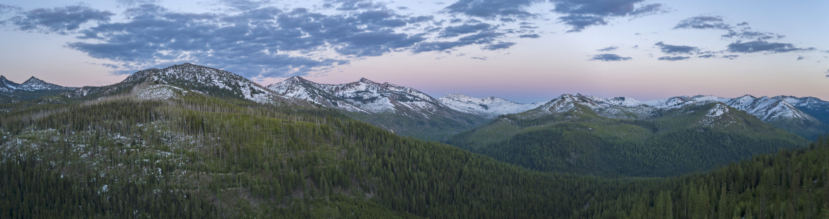
SOURCES/
END NOTES
Search Engine Market Share (November 2021), StatCounter
Use Local SEO Marketing to Increase Traffic, BrightEdge
Ipsos research: Benefits of a Complete Listing (2017); Uncovering the Secrets of the Most Successful Business Profiles on Google, Miles Partnership

